Slide 1
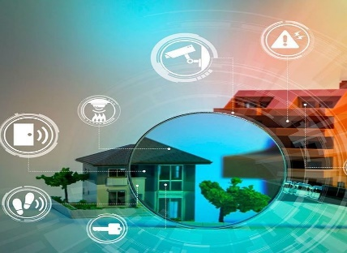
PRESENTATION AT NAFIS 2023 SUMMIT
DIGITIZATION AND DATA MANAGEMENT
IMPERATIVES FOR DELIVERING AFFORDABLE HOUSING
Charles Inyangete, PhD
Co-Founder & MD (Advisory & Asset Management)
Aksum Capital Limited (UK)
November, 2023

Slide 2
PRESENTATION OUTLINE
GLOBAL AND AFRICA CONTEXT FOR REAL ESTATE
TECHNONOGY – DATA MANAGEMENT – HOUSING
DATA AGENDA FOR AFRICA – DRAWN FROM WORK DONE BY CAHF
DATA QUALITY ASSESSMENT – FOCUS ON NIGERIA
APPLICATION OF DATA QUALITY TO LAND – CASE STUDIES
DIGITIZATION AND APPLICATION OF BLOCKCHAIN TECHNOLOGY TO HOUSING
DIGITIZATION OF THE LAND REGISTRY
BLOCKCHAIN TOKENIZATION – TOKENIZATION OF REAL ESTATE
MULTIPLIER EFFECT OF DIGITIZATION ON AFFORDABLE HOUSING
AFFORDABLE HOUSING POLICY – THE NEED FOR IMPACTFUL INVESTMENT
CONCLUSION

Slide 3
Background
Global and Africa Context
Backdrop For Digitized Data
The Imperative of Good Data for Digitization of Real Estate

Slide 4
Global Housing – Multi Trillion $ Opportunity
Developing Affordable Housing: Investment Opportunity—and Challenge
The prospect of trying to fill a gap of 440 million housing units may seem daunting to policy makers, but it could represent a massive opportunity for the private sector.
The investment associated with building the housing needed to close this gap would be $9 trillion to $11 trillion for construction alone.
With the cost of land, we estimate the total could be as much as $16 trillion.
- McKinsey Global Institute

Slide 5
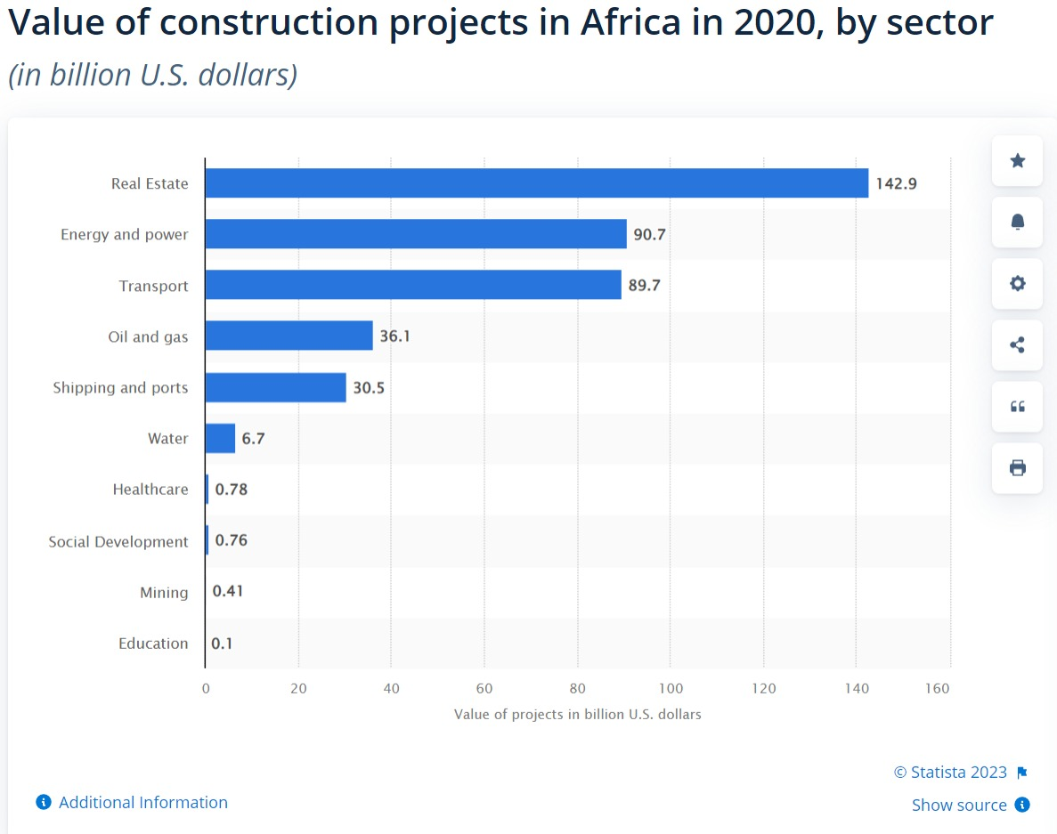
Africa – Value of Construction Projects by Sector
Real estate projects in Africa were valued at nearly 143 billion U.S. dollars in 2020.
Commercial construction had projects exceeding a total value of 118 billion U.S. dollars.
Projects in industrial construction were valued at some 21.6 billion U.S. dollars.
Cultural real estate had projects worth around 300 million U.S. dollars.

Slide 6
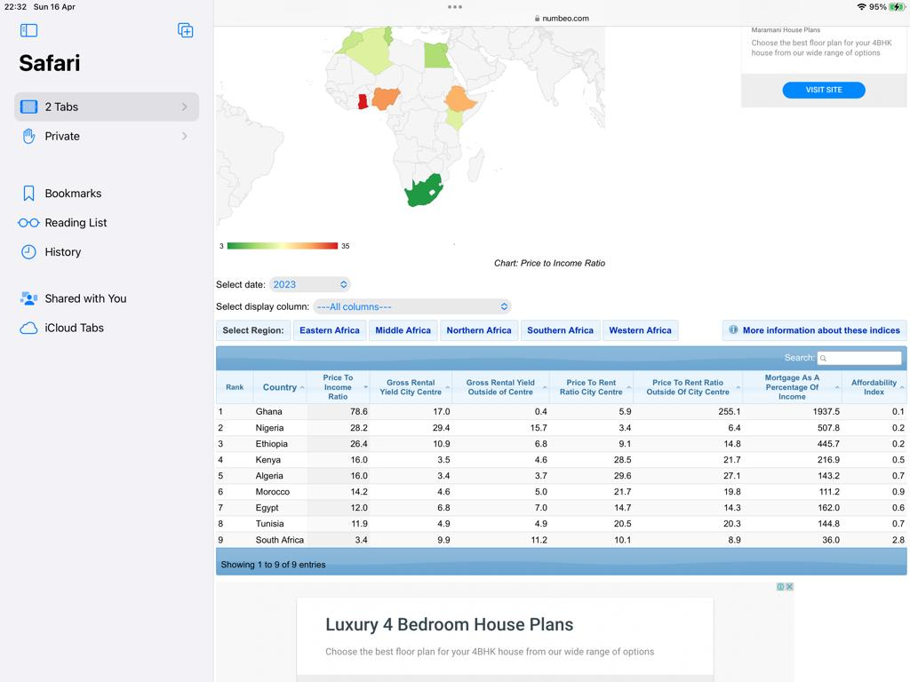
Selected African Countries
Property Price to Income Ratio
Source: Numbeo.com 2023

Slide 7
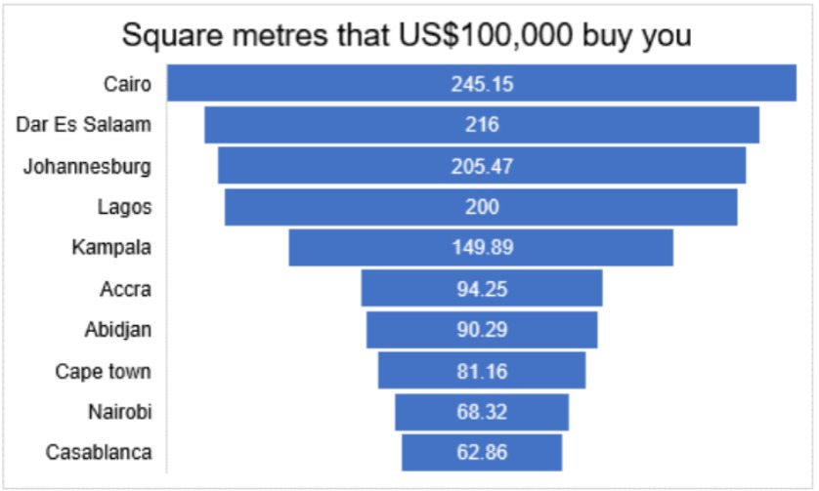
The Figure Shows Relative Affordability of Residential Units in Africa’s Leading Cities Based on Square Meters Purchased with US$ 100,000. 2022

Slide 8
Section one
Technology and Housing
Imperative for Digitization

Slide 9







TECHNOLOGY AND HOUSING
Technology is having a significant impact on the housing industry .
New construction methods and materials make it possible to build homes more quickly and efficiently.
.
Smart home technology help homeowners save on energy bills and make homes more secure.
Real estate websites and apps connects homebuyers and sellers to meet and make offers online.
Online property management software and apps handle tenant applications, track rent payments, etc.
Technology has influenced the housing industry in the way homes are built, managed, and sold.
Further technological advancements, will lead to changes and improvements in the housing industry.

Slide 10
Master Data Management (MDM):
Data Security
MDM focuses on creating a single, reliable source of data by aggregating information from various data sources.
It involves tools and processes for maintaining consistent and accurate master data to support informed business decisions.
Data security specialists are crucial in safeguarding data.
They manage encryption, protect against unauthorized access, and prevent accidental data breaches or deletions.
TYPES OF DATA MANAGEMENT
Data Stewardship:
Big Data Management:
Data stewards are responsible for enforcing data management policies across an organization.
They oversee data collection and movement, ensuring that best practices are implemented
It focuses on data intake, data integrity, and storage of vast amounts of raw data that other teams use for operations improvement, security, and business intelligence.
Data Quality Management:
Data Governance:
Data Warehousing:
Data quality managers work to identify and rectify issues in collected data, such as duplicate records, inconsistent data versions, and other quality problems.
They support the data management system by ensuring data is accurate and reliable.
Data governance establishes policies for data intake, flow, and protection within an organization.
It acts as a framework that outlines rules and guidelines for data management.
Involves the infrastructure and systems used to aggregate and store data for in-depth analysis.
Provides the foundation for extracting valuable business insights from data, often stored in physical or cloud-based warehouses

Slide 11
Tenant Screening and Selection:
DATA MANAGEMENT IN AFFORDABLE HOUSING
Rent Collection and Payment Tracking:
Data management systems can store and analyze applicant information, including credit histories and rental references.
Algorithms can help in objective tenant selection, reducing the risk of discrimination and ensuring a fair process.
.
Smart meters and data analysis can help monitor and manage energy consumption in affordable housing units.
Data-driven insights can lead to energy-saving initiatives and reduced utility costs for both tenants and property owners.
Affordability Assessments:
Property Management:
Data systems can track maintenance schedules, repair requests, and maintenance costs.
Predictive maintenance using historical data can reduce unexpected repair expenses.
Data can be used to determine the affordability of housing options based on income levels, household size, and location.
This helps policymakers and organizations in developing targeted housing programs.
Property Allocation:
Data-driven allocation systems can prioritize individuals and families in need, ensuring that those with the greatest need receive affordable housing.

Slide 12
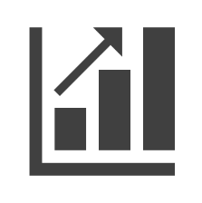
GLOBAL DATA MANAGEMENT COMPANIES SPECIALIZING IN AFFORDABLE HOUSING
Yardi Systems
Landtech
The Affordable Housing platform offers features for compliance, reporting, financial management, and tenant services.
Provides the property industry with the tools they need to facilitate their daily operations.
DATA MANAGEMENT
COMPANIES
MRI Software:
Squareyards
SPECIALIZING IN AFFORDABLE
HOUSING
Helps organizations streamline operations and ensure regulatory compliance. Their solutions include budgeting, reporting, and tenant management tools
Grant users access to an inventory of residential and commercial properties, harnessing data-driven methodologies and market.
PropertyGuru
Landchecker
Access to thousands of properties for sale and rent with detailed information about each property, including maps and photos
An all-in-one source, of property information and data analysis tools, to help professionals and homeowners make informed decisions, faster.

Slide 13
AFRICAN DATA MANAGEMENT COMPANIES SPECIALIZING IN AFFORDABLE HOUSING
ConDigital
houseME
provides cloud project and enterprise management for construction companies in Africa
Provides an online auction mechanism where landlords receive bids on their rental properties from prospective tenants.
DATA MANAGEMENT
COMPANIES
Instant Property
nawy
offers Software as a service to the Real Estate Industry empowering sector players with both technology and data to help them with their digital transformation.
Offer Various Services Including Brokerage and Property Financing Services
SPECIALIZING IN AFFORDABLE
HOUSING
Crowd Prop
Jumba
platform that enables individuals to invest in real estate through the form of crowdfunding.
A Kenyan construction technology platform founded in April 2022 that simplifies B2B purchase and financing of construction materials

Slide 14
NIGERIA DATA MANAGEMENT COMPANIES SPECIALIZING IN AFFORDABLE HOUSING
CutStruct Technology LTD
Real estate information centre
A digital marketplace that servers as a one-stop-shop for all construction needs and also shields construction stakeholders against the risk they will ordinarily experience in the industry
Provide access hard to get real estate data and information in a timely and cost effective basis by providing intelligent and user-friendly information solutions.
DATA MANAGEMENT
COMPANIES
Estate Intel
VENCO
SPECIALIZING IN AFFORDABLE
HOUSING
A data platform that helps organisations interacting with the real estate and construction industry make faster and smarter decisions.
Offers a suite of solutions designed to streamline property management such as; Collections management, Utility vending, Charge administration
Pison Housing Company
Spleet
Map, segment, analyse, and classify the Nigerian residential and commercial real estate markets.
Offer products that find apartments and pays monthly, carry out due diligence and verify tenants, request facility management for property and apply for rental loans.

Slide 15
Section Two
DATA AGENDA FOR AFRICA
THE IMPERATIVES FOR DIGITIZATION

Slide 16
CENTRE FOR AFFORDABLE HOUSING FINANCE IN AFRICA;
DATA AGENDA FOR HOUSING IN AFRICA OVERVIEW
Market intelligence & data is fundamental market infrastructure for the housing finance sector
The objective of the Data Agenda is to catalyse the provision and dissemination of this data
01
02
The vision is the development of a housing and housing finance data universe in Africa that provides regulators, policymakers, developers and housing financiers with accurate, relevant and current data.
The unavailability of data and market intelligence undermines the private sector participation and good policy engagement in affordable housing finance
03
04

Slide 17
CAHF: THE DATA AGENDA FOR HOUSING IN AFRICA IN PARTNERSHIP WITH 71POINT4 AND REALL
1
Data Landscape reports for all countries
4
A Market Shaping Indicators Metadata Document for the 115 Market Shaping Indicators
Databases of the 115 Market Shaping Indicators in 2020, for all countries. To be collected annually and extended to new countries over time.
2
5
A special B40 dashboard using USAID’s Demographic and Health Survey (DHS) database.
3
Country profiles; Kenya, Uganda, Tanzania, Mozambique, Nigeria and Ghana
An online dashboard which displays the data collected against the Market Shaping Indicators for each country in Africa.
6

Slide 18
THE DATA AGENDA FOR AFRICA INVOLVES FIVE BROAD COMPONENTS
Collect, assess and curate available data (public, private and deal-specific) relevant to increased investment in affordable housing across Africa
DATA COLLECTION AND ASSESSMENT
01
Encourage data owners to make existing data available & improve quality /coverage of data.
Commissioning partners to gather additional data (primary data)
02
IDENTIFY DATA GAPS & AND CLOSE KEY DATA GAPS
Integrate, optimise and expand our set of knowledge products & data tools to produce a set of key data outputs that are widely used
INTEGRATION & EXPANSION OF DATA TOOLS, PRODUCTS
03
Build the capacity of partner institutions to analyse data and engage with data-driven outputs
04
CAPACITY BUILDING
Promote the importance of accessible, credible data as a catalyst in the affordable housing market
CREDIBLE DATA PROMOTION
05

Slide 19
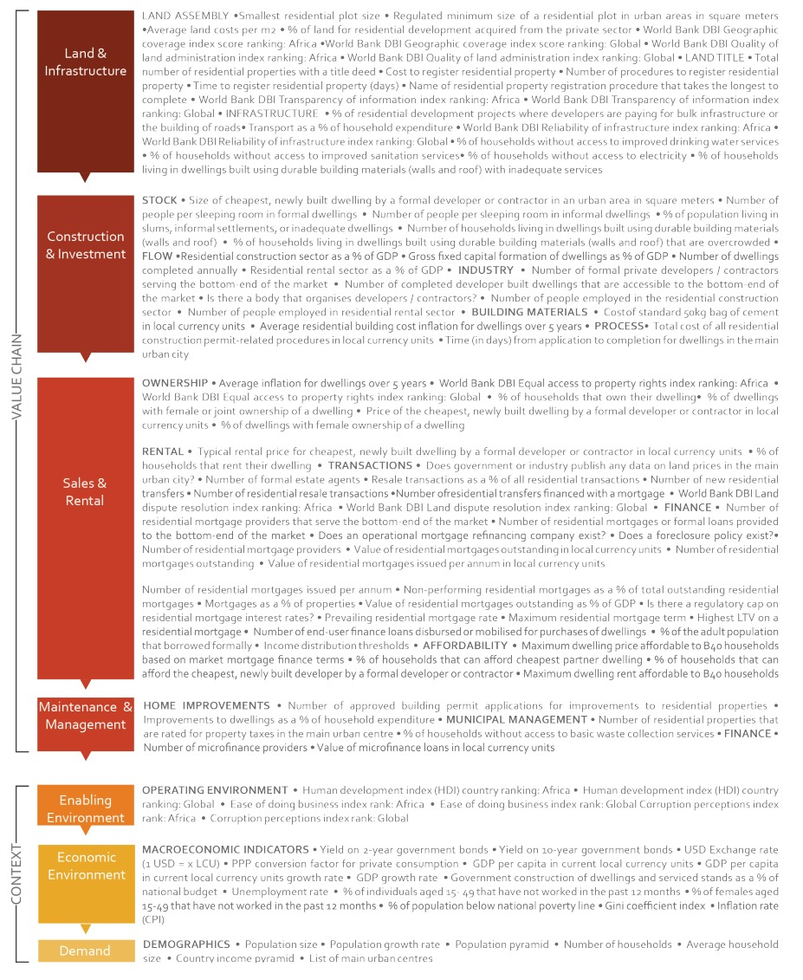
A DATA AGENDA FOR HOUSING IN AFRICA: 115 HEADLINE MARKET SHAPING INDICATORS HAVE BEEN IDENTIFIED ACROSS THE VALUE CHAIN AND CRITICAL CONTEXTUAL AREAS
Land & Infrastructure
Land Assembly
Land Title
Infrastructure
Construction & Investment
Stock
Flow
Industry
Building Materials
Process
Value
chain
Sales & Rental
Ownership
Rental
Transactions
Finance
Affordability
Maintenance & Management
Home Improvements
Municipal Management
Finance
Enabling Environment
Operating Environment
Economic Environment
Context
Macroeconomic Indicators
Economic Environment
Macroeconomic Indicators

Slide 20
Section Three
DATA QUALITY ASSESSMENT
DIGITIZATION THE ESSENCE OF DATA QUALITY

Slide 21
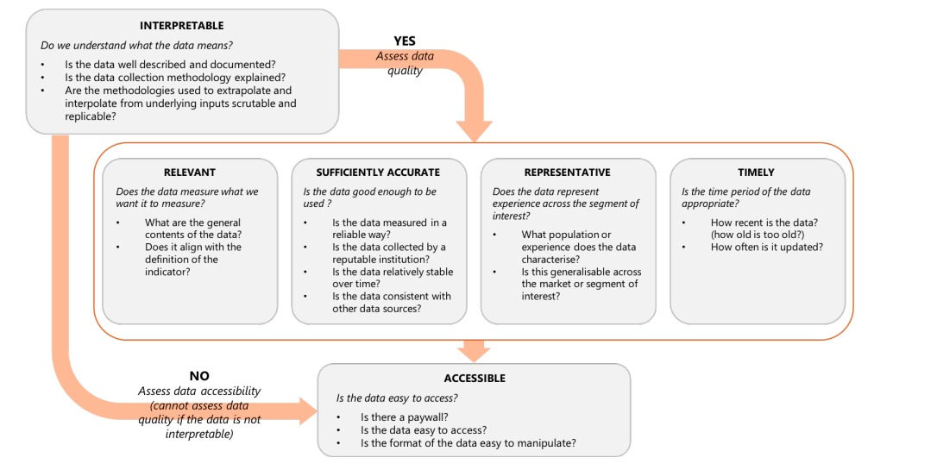
DATA QUALITY ASSESSMENT FRAMEWORK

Slide 22
AN ASSESSMENT OF DATA AVAILABILITY
Some Government Agencies as Data Sources:
NBS
NPC
CBN
NMRC
FMBN
Nigeria National Bureau of Statistics
National Population Commission
Central Bank of Nigeria
Nigeria Mortgage Refinance Company
Federal Mortgage Bank of Nigeria
NBS publishes demographic, socio-economic, and economic statistics on its website through downloadable reports and open data platforms.
The National Population Commission is responsible for producing data on the Nigerian people and economy.
Data on Nigeria's housing finance sector is primarily collected by the Central Bank of Nigeria (CBN) and shared on various platforms.
NMRC hosts the Housing Market Information Portal (HMIP), a decision-making tool supporting affordable housing and housing finance growth in Nigeria.
Provide long-term credit facilities to mortgage institutions in Nigeria.
Data sources for climate issues related to housing are the National Environmental Standards and Regulations Enforcement Agency (NESREA) monitors environmental compliance and enforcement, the Nigerian Meteorological Agency (NiMet) provides weather and climate information, the Nigerian Hydrological Services Agency (NIHSA) provides hydrological information and the National Emergency Management Agency (NEMA) provides disaster management information.
World Bank data and the Demographic and Health Survey (DHS) program by USAID are widely used as data sources.
Commercial banks provide data through their annual reports and financial statements, accessible on their websites.

Slide 23
The delivery of affordable housing and the development of the mortgage sector often require collaborative efforts between various government agencies.
These agencies includes:
FHA
FHFL
FEDERAL HOUSING AUTHORITY
FAMILY HOMES FUNDS
FHA delivers national housing programmes, planning approvals & permits its website through downloadable application forms, reports and open data platforms.
FHF is responsible for the delivery of social housing - also responsible for producing data on social housing
The data sources for climate issues related to housing are the National Environmental Standards and Regulations Enforcement Agency (NESREA) monitors environmental compliance and enforcement, the Nigerian Meteorological Agency (NiMet) provides weather and climate information, the Nigerian Hydrological Services Agency (NIHSA) provides hydrological information and the National Emergency Management Agency (NEMA) provides disaster management information.

Slide 24
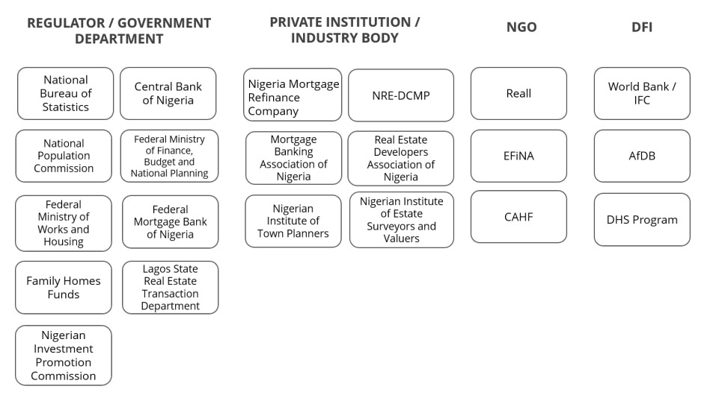
KEY DATA PRODUCERS AND CUSTODIANS IN NIGERIA

Slide 25
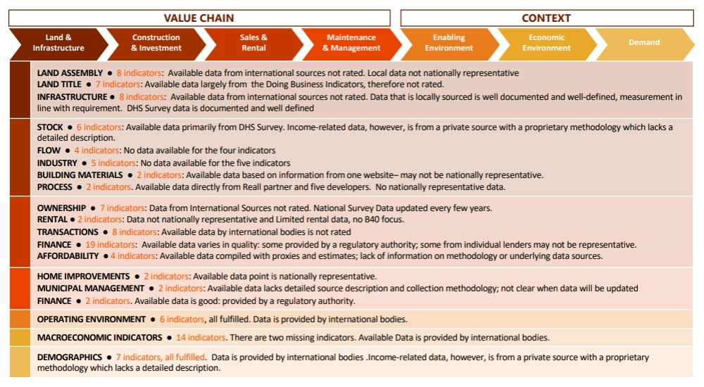
OVERVIEW OF DATA AVAILABILITY AND QUALITY
Data published by these institutions has allowed CAHF and 71Point4 to populate available data according to the Headline Indicator Market Shaping Framework
The Figure illustrates this data collection activity per component by including a high-level characterization of data quality for indicators that were populated.

Slide 26
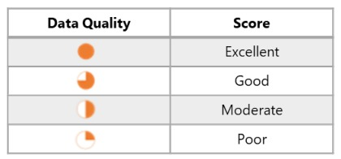
Quality Assessment: Scoring

Slide 27
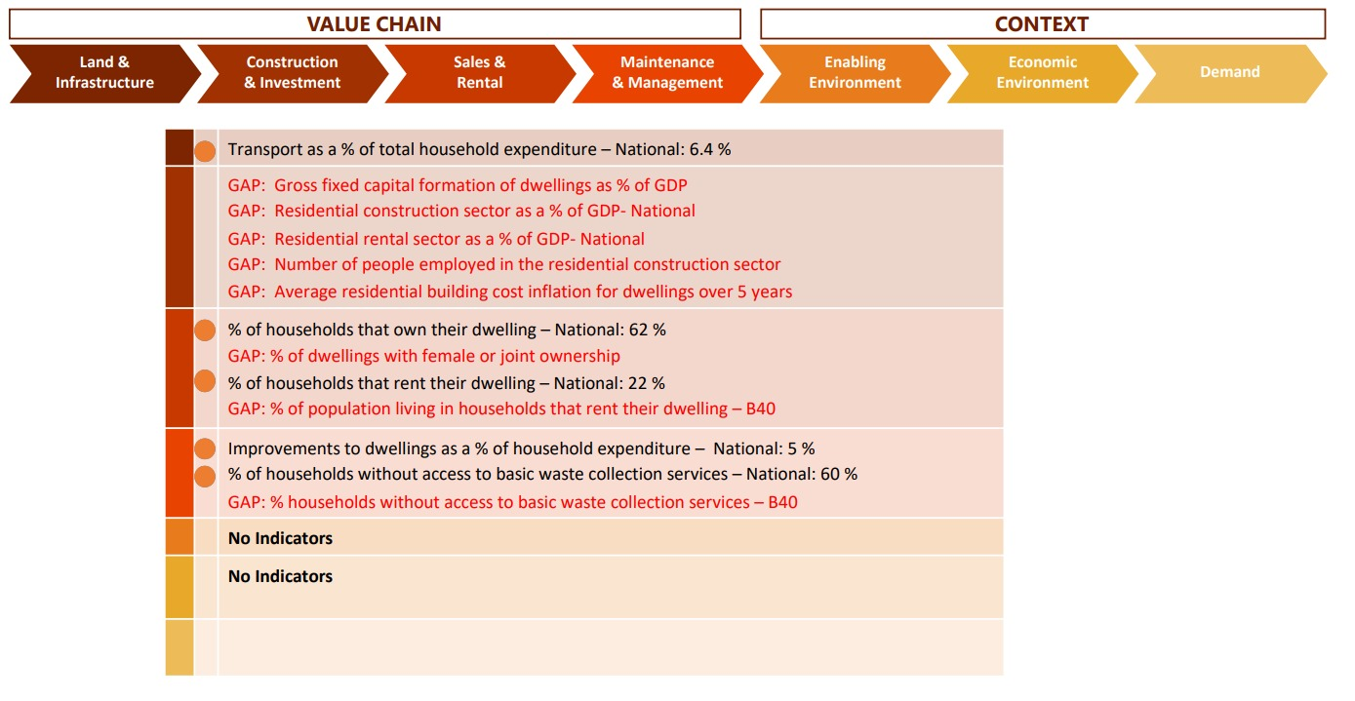
INDICATORS POPULATED WITH DATA FROM THE NBS

Slide 28
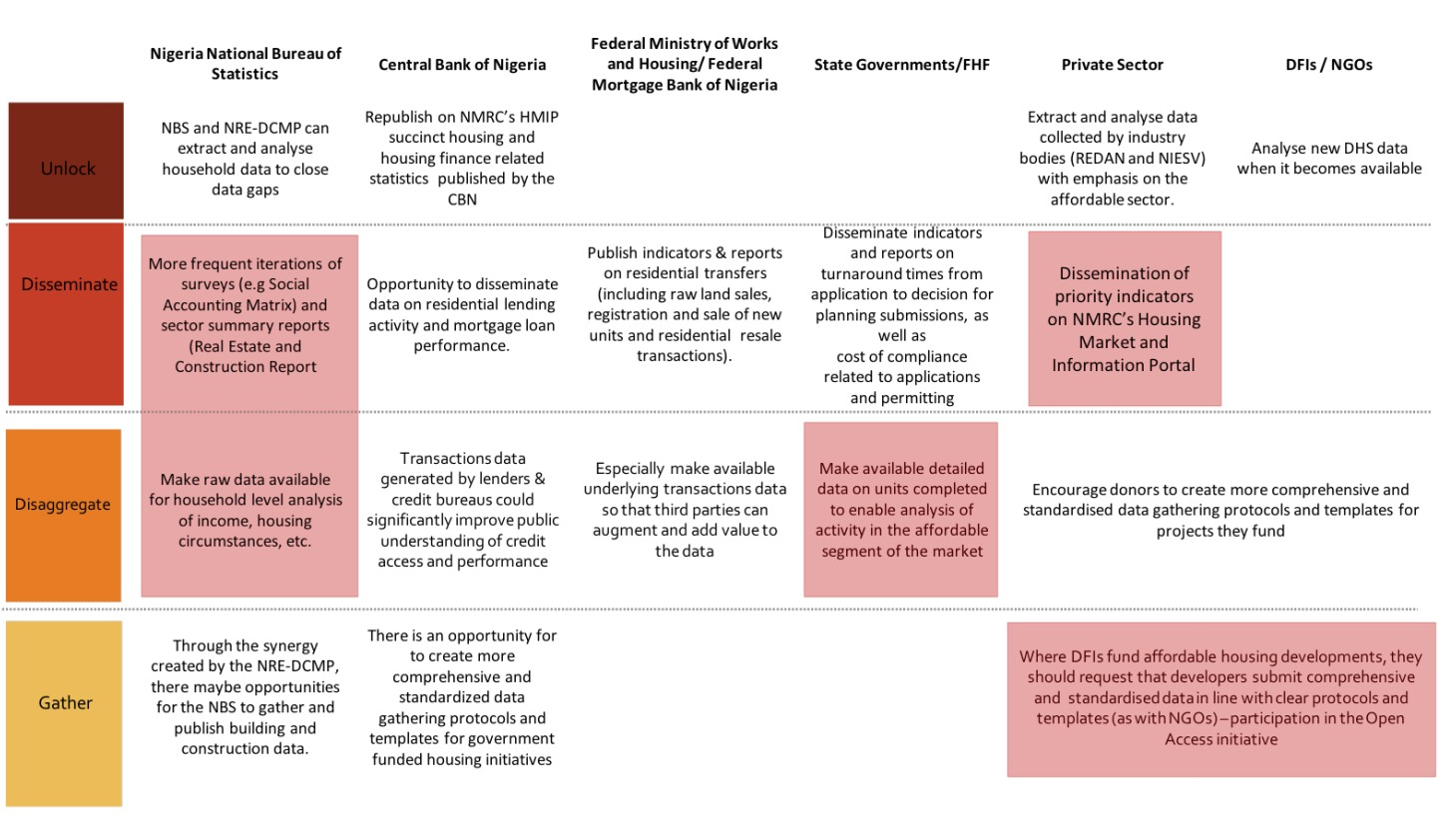
THE TABLE BELOW SUMMARISES SOME OF THE KEY CONSIDERATIONS THAT MAY FRAME NEXT STEPS FOR DATA PRODUCERS AND CUSTODIANS GOING FORWARD, WITH HIGH VALUE INTERVENTIONS IN RED. MUCH OF THE DATA THAT CAN PROVIDE RICH INSIGHTS INTO
NIGERIA’S HOUSING MARKET

Slide 29
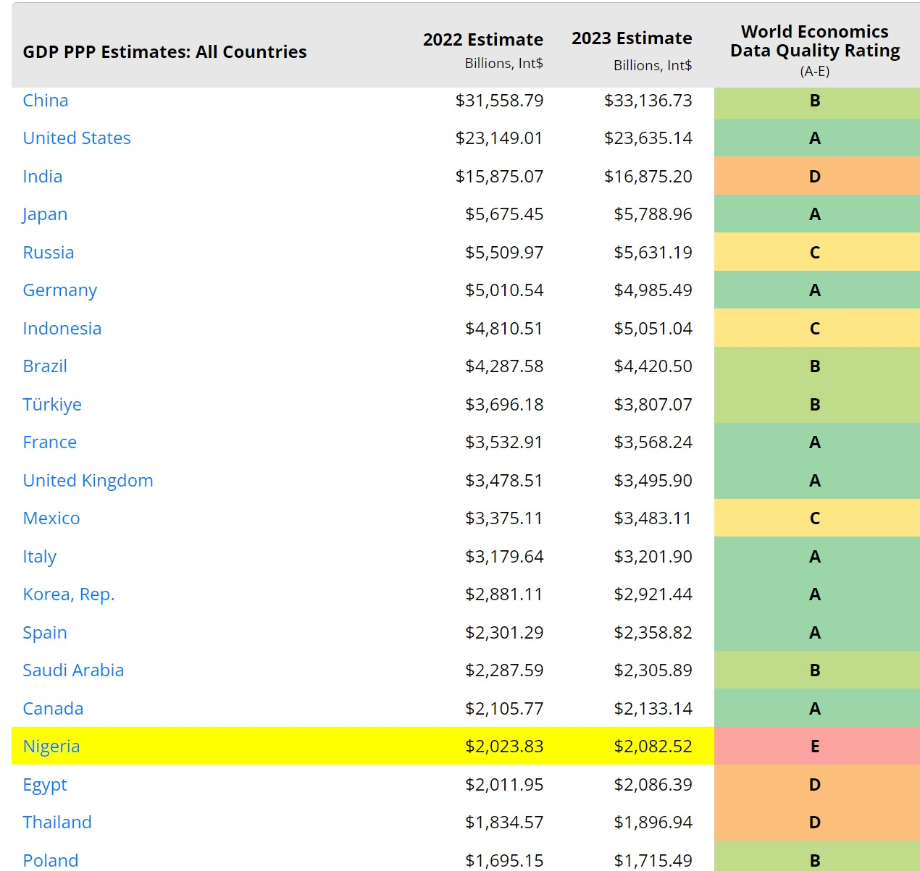
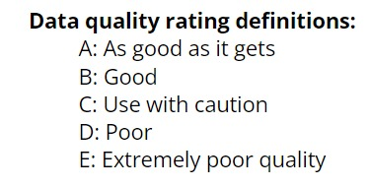
LATEST GLOBAL ESTIMATES FOR GROSS DOMESTIC PRODUCT IN PPP INT$ ADJUSTED FOR BASE YEAR AND INFORMAL ECONOMY
Data source: World Economics Research, London

Slide 30
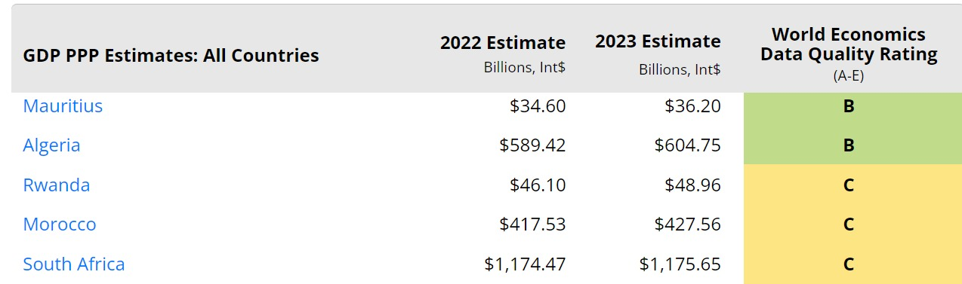
LATEST AFRICA’S ESTIMATES FOR GROSS DOMESTIC PRODUCT IN PPP INT$ ADJUSTED FOR BASE YEAR AND INFORMAL ECONOMY
Data source: World Economics Research, London

Slide 31
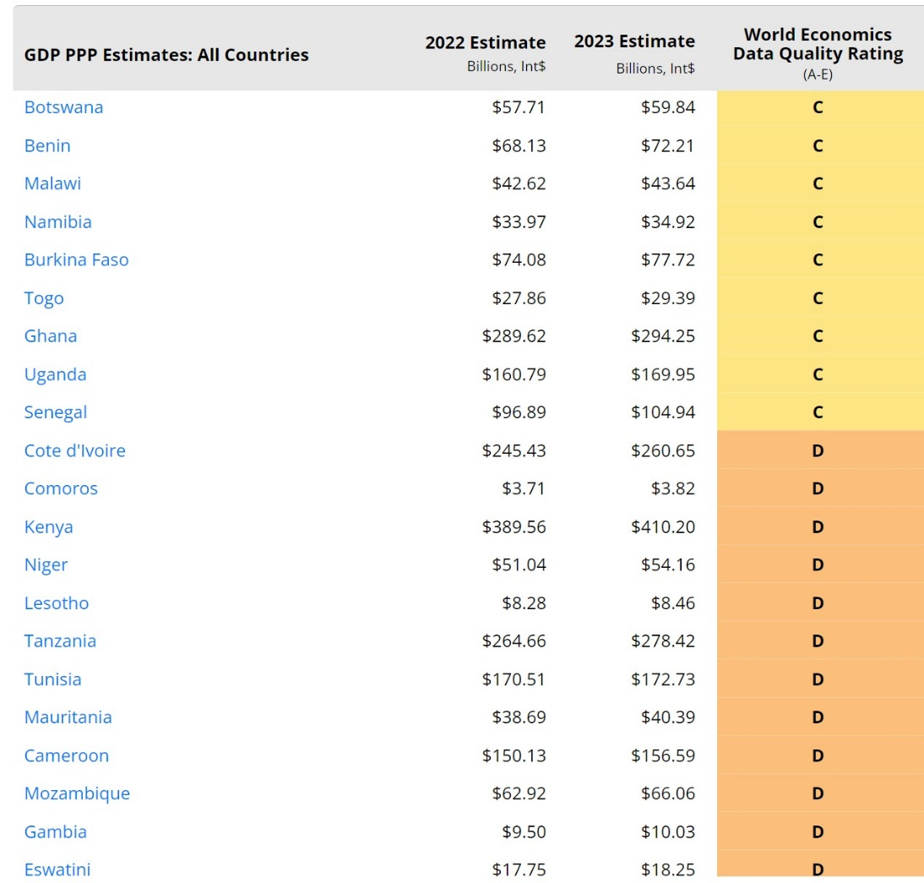
LATEST AFRICA’S ESTIMATES FOR GROSS DOMESTIC PRODUCT IN PPP INT$ ADJUSTED FOR BASE YEAR AND INFORMAL ECONOMY
Data source: World Economics Research, London

Slide 32
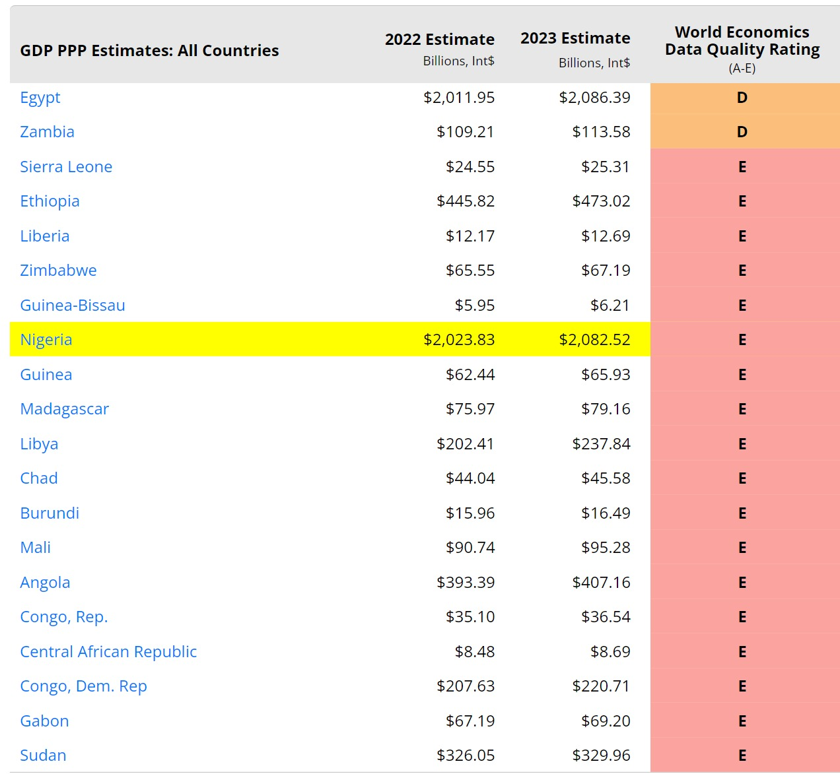
LATEST AFRICA’S ESTIMATES FOR GROSS DOMESTIC PRODUCT IN PPP INT$ ADJUSTED FOR BASE YEAR AND INFORMAL ECONOMY
Data source: World Economics Research, London

Slide 33
Section Four
DIGITIZATION AND APPLICATION OF BLOCK CHAIN
IMPERATIVES FOR AFFORDABLE HOUSING

Slide 34
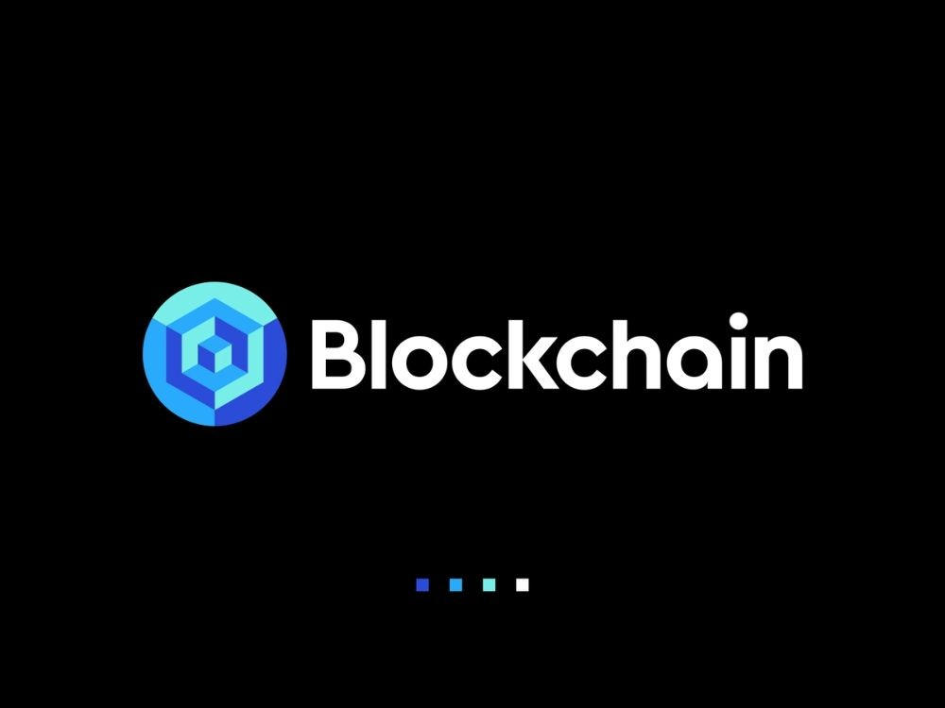


Slide 35

Foreword:
Decentralization and Society
Blockchain Decentralization and Society
We acknowledge a need to set this presentation within the context of a broader relationship between blockchain and society.
The current centralization of the internet allows a few private companies to effectively control the commons/marketplace of ideas. There are reported cases of dominant big technology companies not acting in the best interest of society.
Some see blockchain as a revival of open-protocol ethos, enabling self-sovereign ID, Peer to Peer (P2P) value exchange, etc.
The drive for open and democratic values online should consider the political powers of technology giants, and social attitudes towards decentralized governance structures.

Slide 36
Intro: Why Blockchain
Makes Sense for Real Estate
Why Blockchain Makes Sense for Real Estate in Nigeria
The technology is decentralized, fault-tolerant, and tamper-resistant; offering security and resiliency.
Blockchain is disruptive for land governance, it can promote property rights formalization, registry modernization, and the collection/analysis of data.
Blockchain can generate increased efficiency and lower transaction costs in the global real estate sector.
The technology allows for improved liquidity of property, financial inclusion, and increased foreign investment.

Slide 37
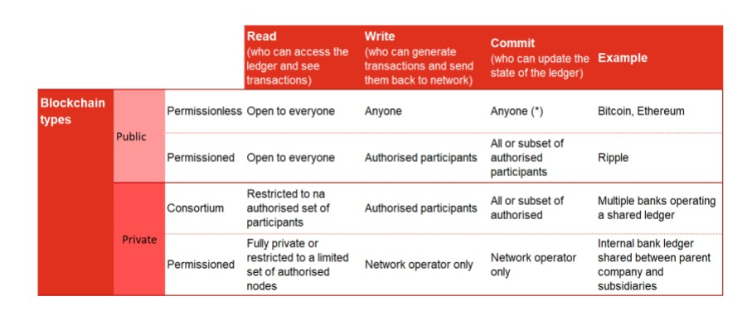
Types of Blockchain:
Public - Private: Consortium-Permissioned and Permissionless

Slide 38
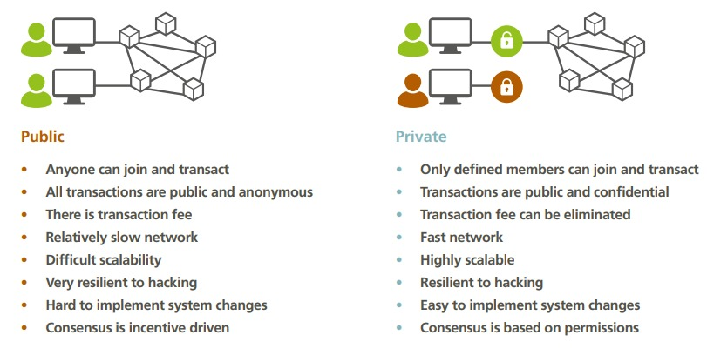
Public and Private Blockchain Types

Slide 39
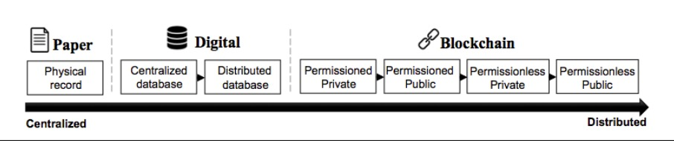
Figure 2. Centralized vs. distributed systems of record
Centralized vs Distributed Systems Record

Slide 40
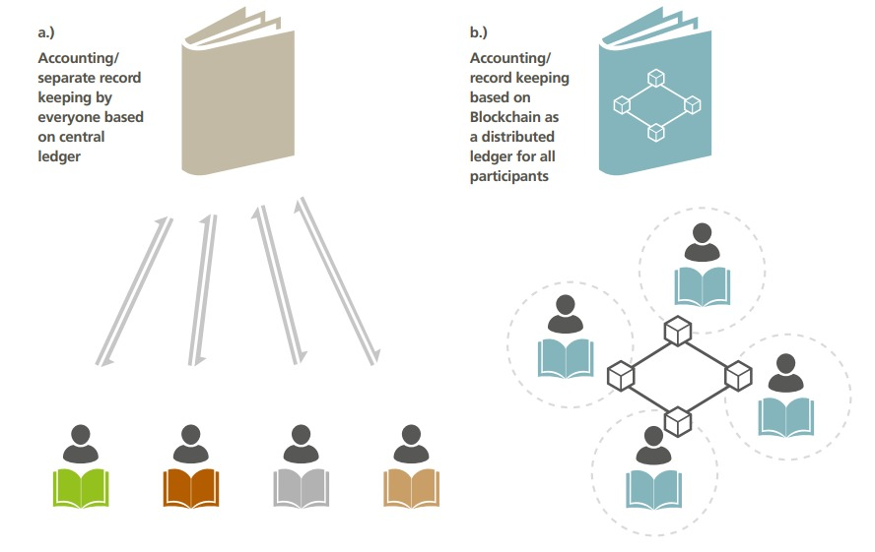
Centralised (a.) and Distributed (Blockchain) Record Keeping (b.)

Slide 41
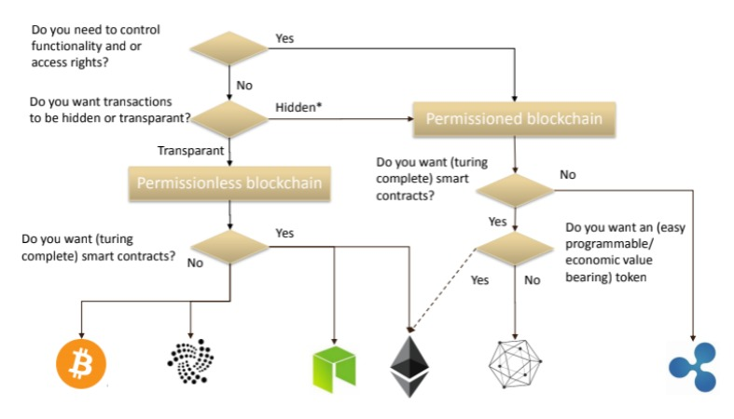
Decision Tree - Which Blockchain?

Slide 42
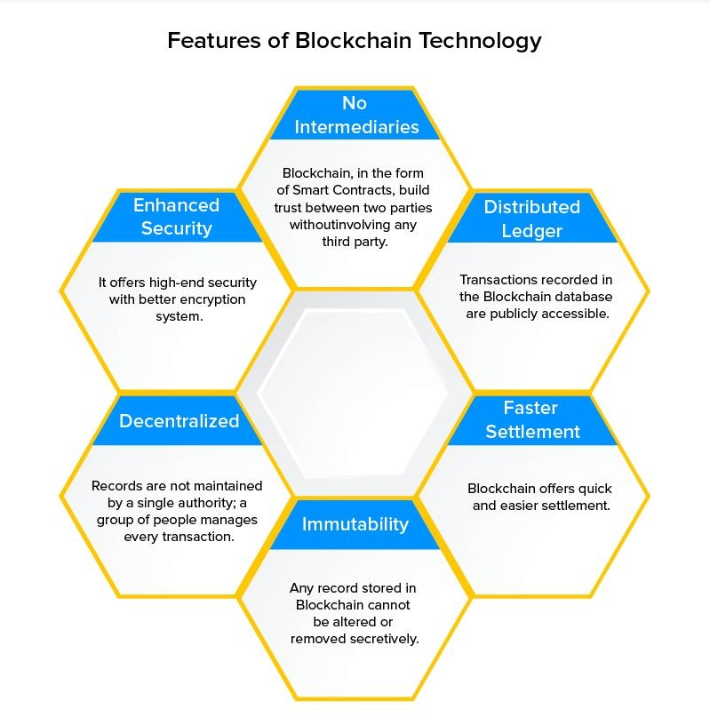
Overview
Blockchain Overview
Blockchain is a digital ledger that maintains information in a secure and transparent manner.
It consists of a chain of blocks that contain validated and confirmed transactions.
Decentralized and distributed among a network of users.
No single user has complete control over the information, making it more secure and resistant to tampering or fraud.
Blockchain uses cryptography to secure and verify transactions.
Each transaction is encrypted and linked to the previous transaction, creating a chain of verified transactions that cannot be altered or deleted.
Blockchain technology has potential applications in finance, real estate, Land registry, supply chain management, and more.
It can improve transparency, security, and efficiency in various industries

Slide 43
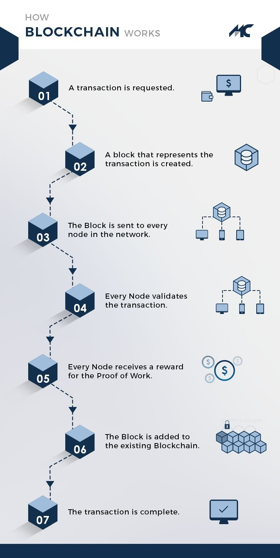
HOW DOES BLOCKCHAIN WORK
How Does Blockchain Work
Creation of Transaction: A user creates a new transaction and signs it with their private key.
Propagation of Transaction: The transaction is broadcasted to the network of nodes for verification and validation.
Verification: The nodes on the network verify that the transaction meets the blockchain protocol's requirements.
Inclusion in a Block: The transaction is grouped together with other verified transactions and added to a block.
Consensus: The block is verified and approved by the network of nodes using a consensus algorithm.
Confirmation: Once the block is added to the blockchain, the transaction is considered confirmed, and the recipient's digital assets or information are transferred to their account.
Tamper-Proof: The transaction is tamper-proof due to the use of cryptography, consensus, and immutability.

Slide 44
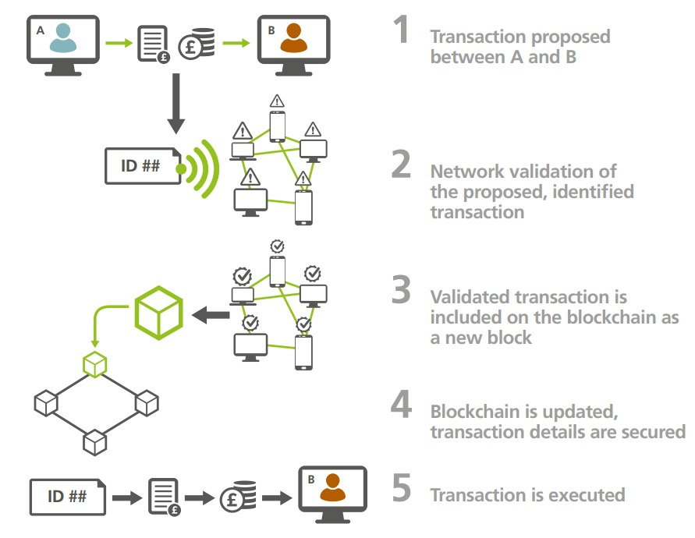
Transaction on the Blockchain

Slide 45
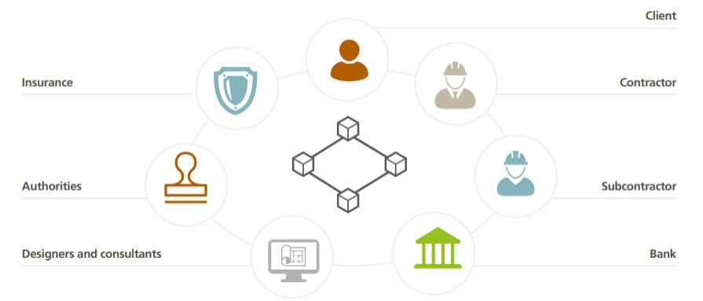
Collaborative Project Ecosystem

Slide 46
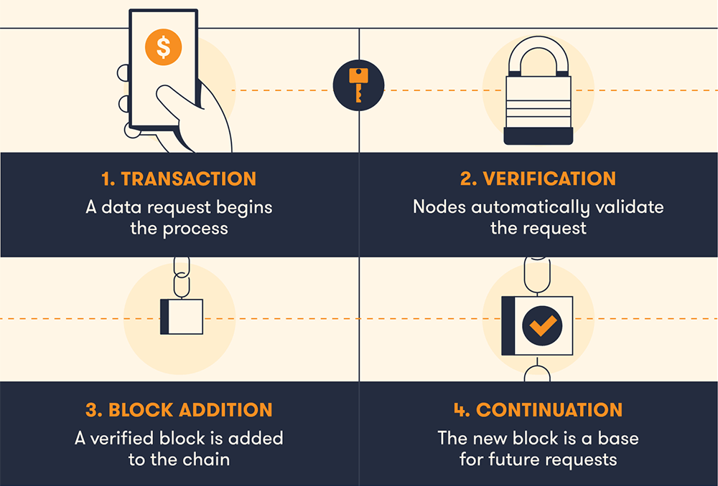
Recap on Blockchain

Slide 47
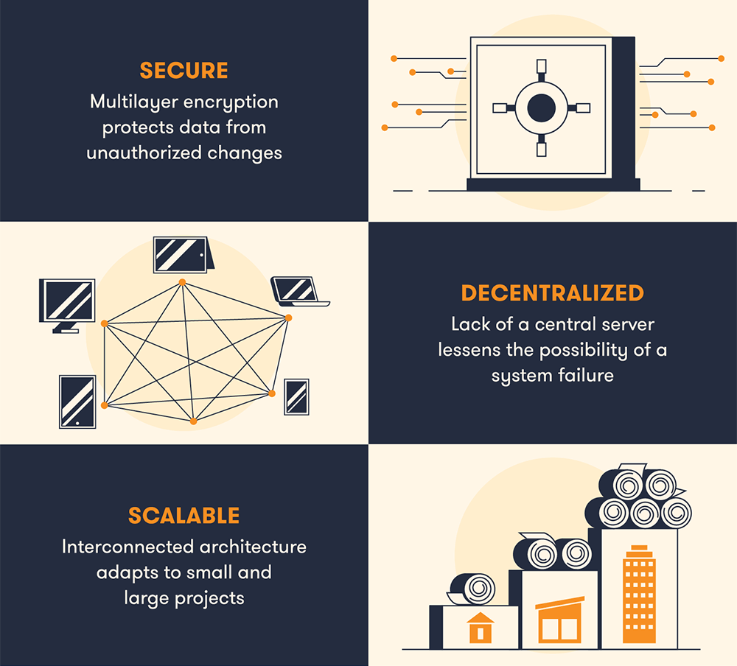
Recap Benefits of Blockchain

Slide 48
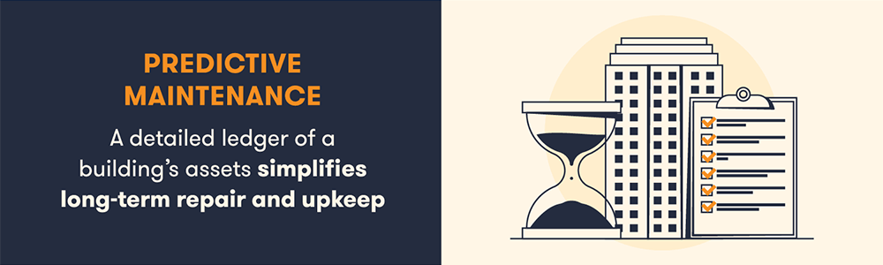
Benefits of Blockchain to the Construction Industry

Slide 49
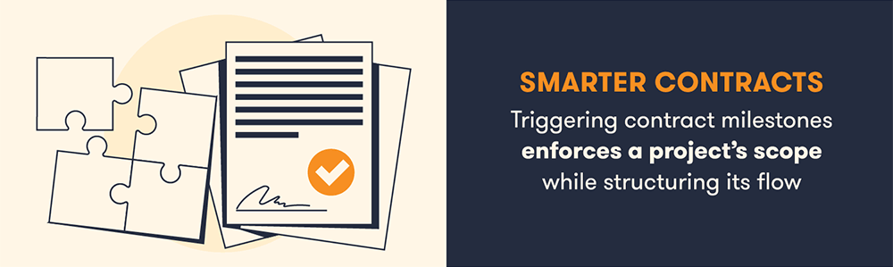
Benefits of Blockchain to the Construction Industry contd…

Slide 50
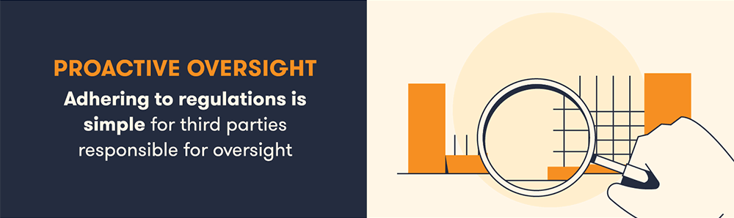
Benefits of Blockchain to the Construction Industry contd…

Slide 51
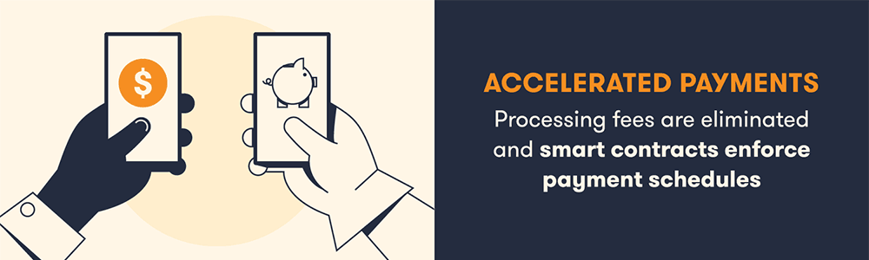
Benefits of Blockchain to the Construction Industry contd…

Slide 52
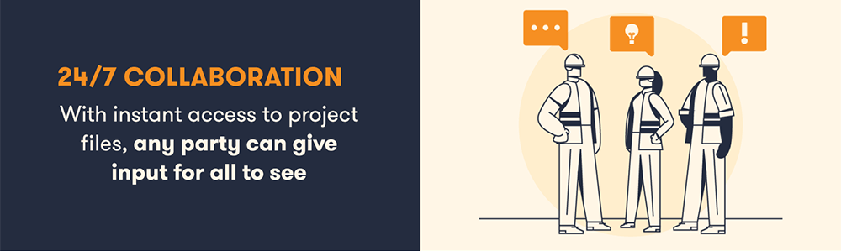
Benefits of Blockchain to the Construction Industry contd…

Slide 53
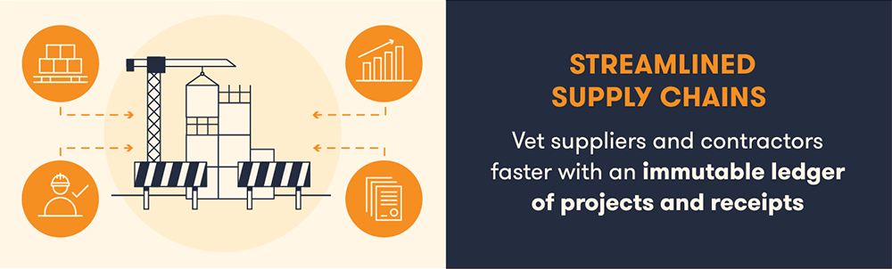
Benefits of Blockchain to the Construction Industry contd…

Slide 54
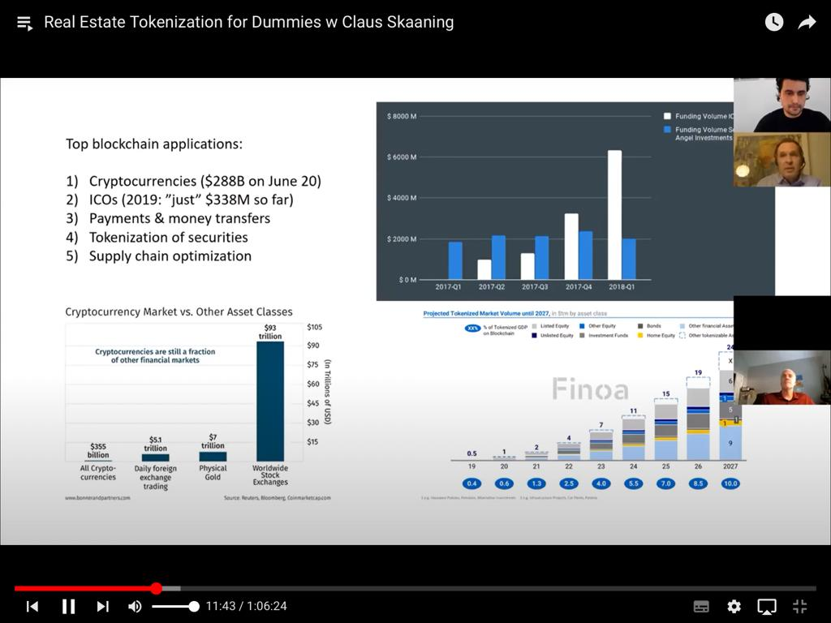
Leading Applications of Blockchain

Slide 55
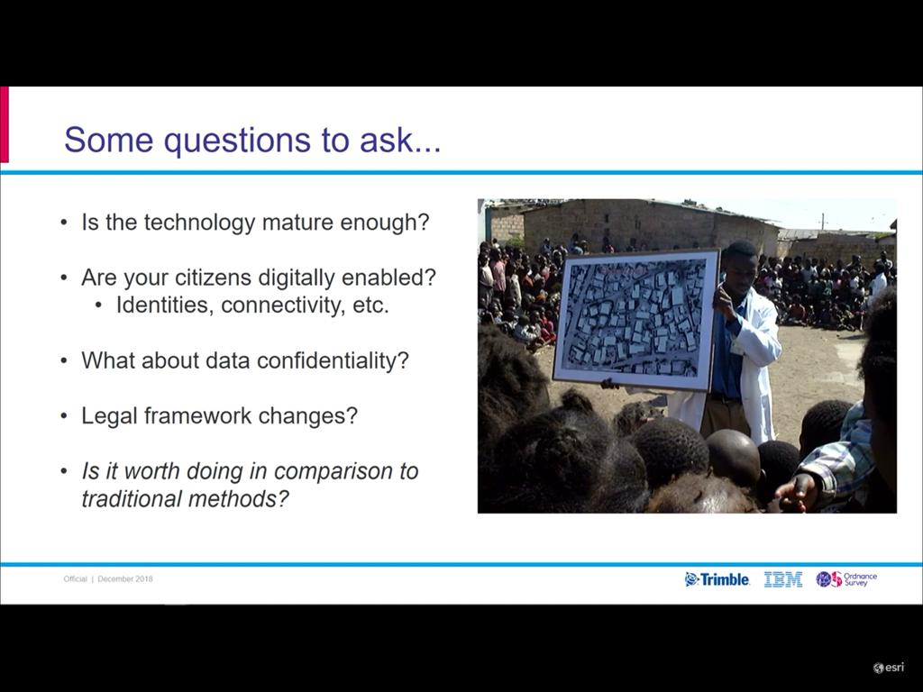
Important Issues to Consider

Slide 56
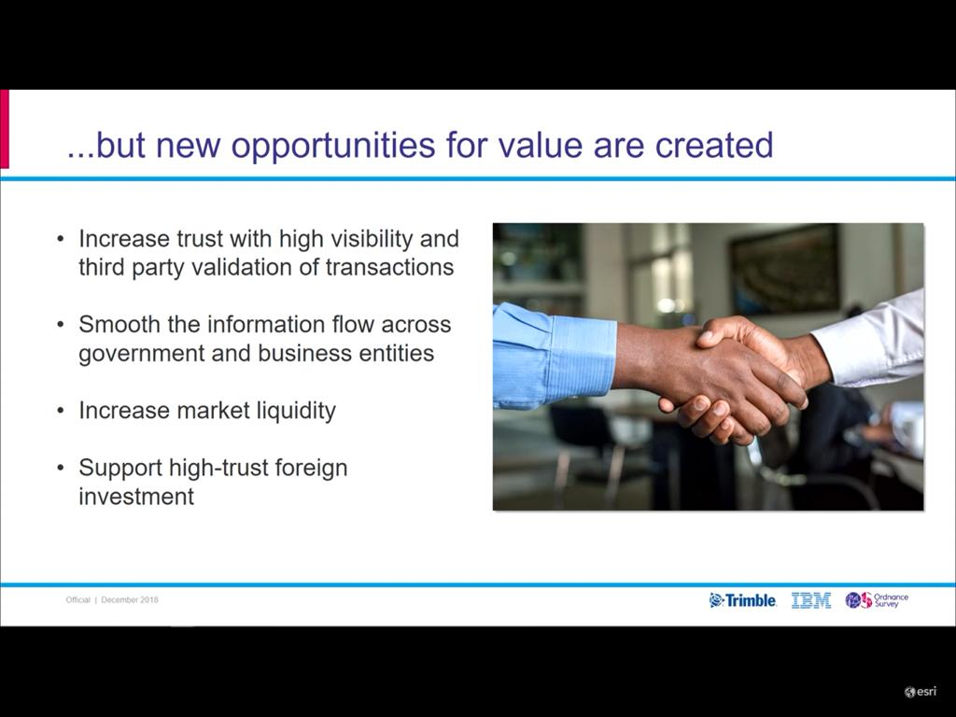
Value Creating Opportunities

Slide 57
Paper Overview
Overview: Case for Blockchain in Real Estate
    Future of Property Rights (RFP’s) seven prerequisites for blockchain introduction into a land registry.
    Conceptual framework: Eight levels of integration from the simple to more radical.
    Five aspects on the future interaction of blockchain and land, from title insurance to regulation.
    Some examples of countries and companies active in blockchain.

Slide 58
Prerequisites for
Blockchain Integration
Prerequisites for Blockchain Integration
An identity solution
Digitized records
Multi-sig Wallets
A private or hybrid blockchain
Accurate data
Connectivity and a technology aware population
A trained professional community
Source: Mike Graglia, Christopher Mellon, and Evan Akin, “Prerequisites for Incorporating Blockchain into a Registry,” FPR Blog (Blog), July 31, 2017, https://www.newamerica.org/international-security/future-property-rights/blog/prerequisites-incorporating-blockchain-registry/.

Slide 59
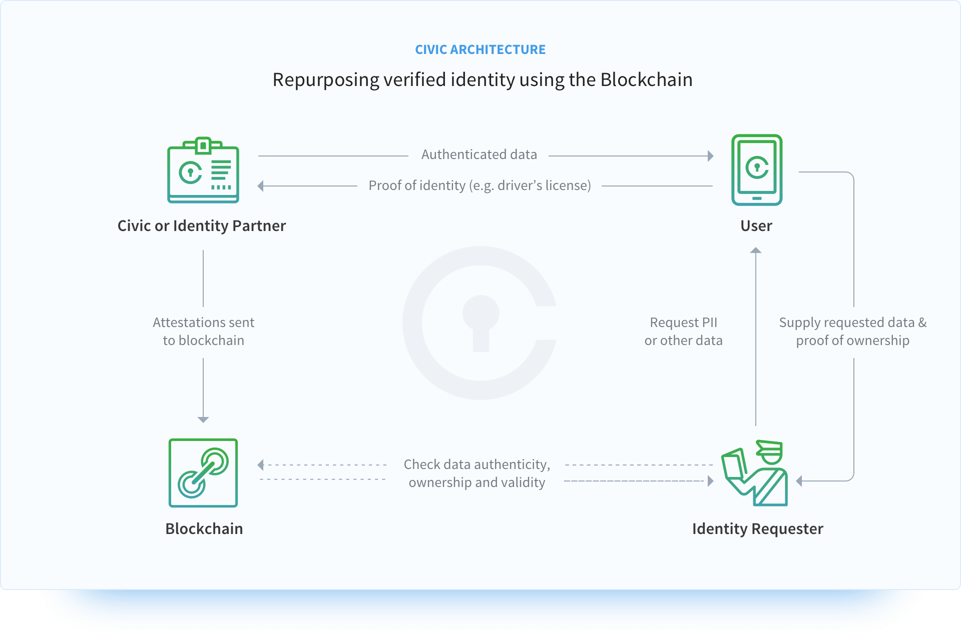
Prerequisites 1:
Identity must come first
Prerequisites 1: Identity Must Come First
Example of Distributed Identity Workflow:

Slide 60
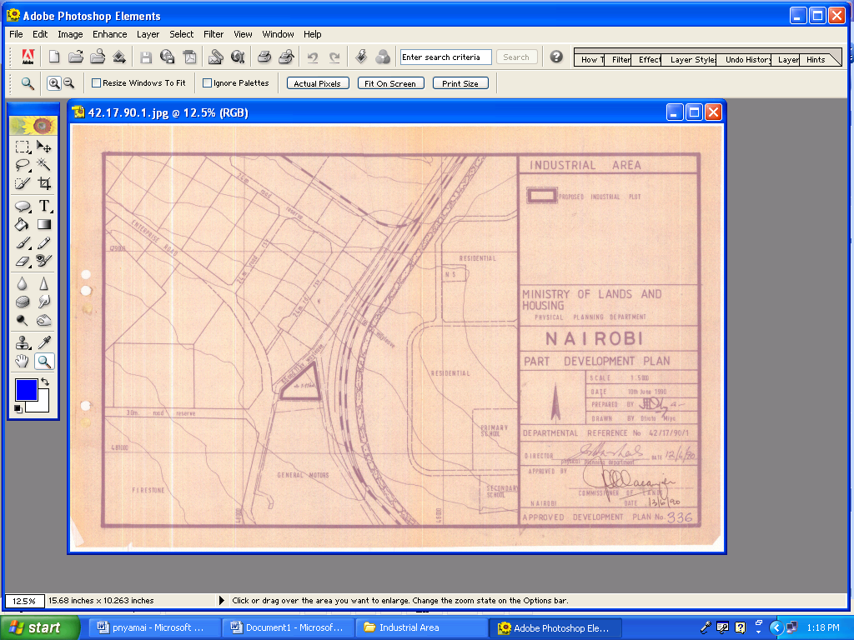
Prerequisites 2:
Digitized Records
Prerequisites 2: Digitized Records

Slide 61
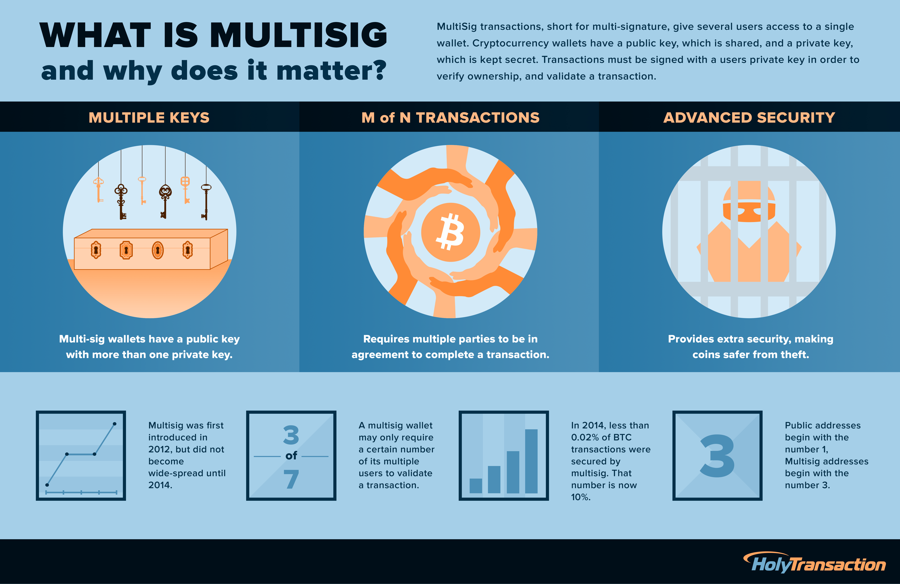
Prerequisites 3:
Multisig Wallets
Prerequisites 3: Multi-sig Wallets

Slide 62
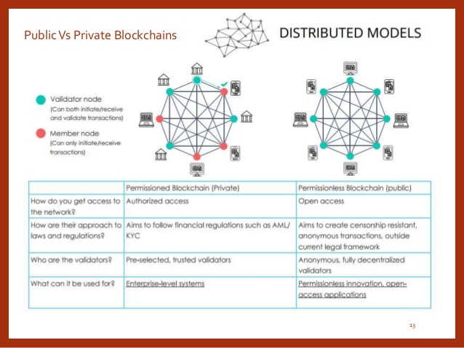
Prerequisites 4:
Private Chains are key
Prerequisites 4: Private Chains are Key
Source: www.slideshare.net/Nitishsharma77/blockchain-73134967

Slide 63
BLOCKCHAIN APPLICATION
Section Five
REAL ESTATE INNOVATION:
:
LAND REGISTRATION SYSTEM

Slide 64
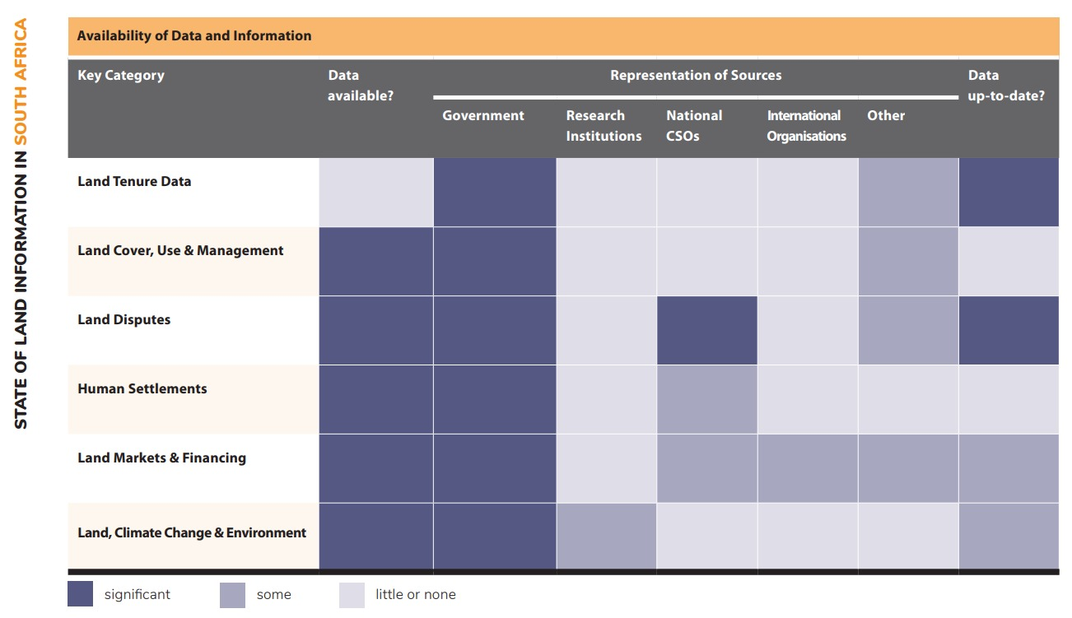
STATE OF LAND INFORMATION SOUTH AFRICA
Source: landportal.org

Slide 65
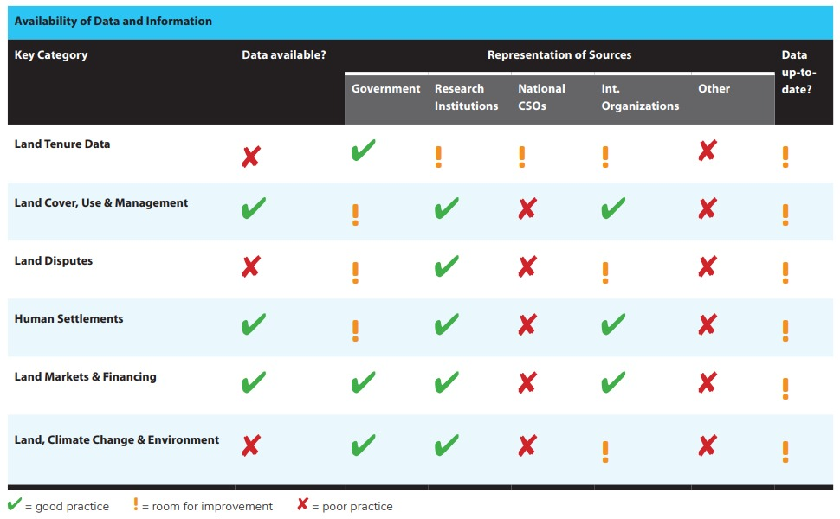
STATE OF LAND INFORMATION TANZANIA
Source: landportal.org

Slide 66
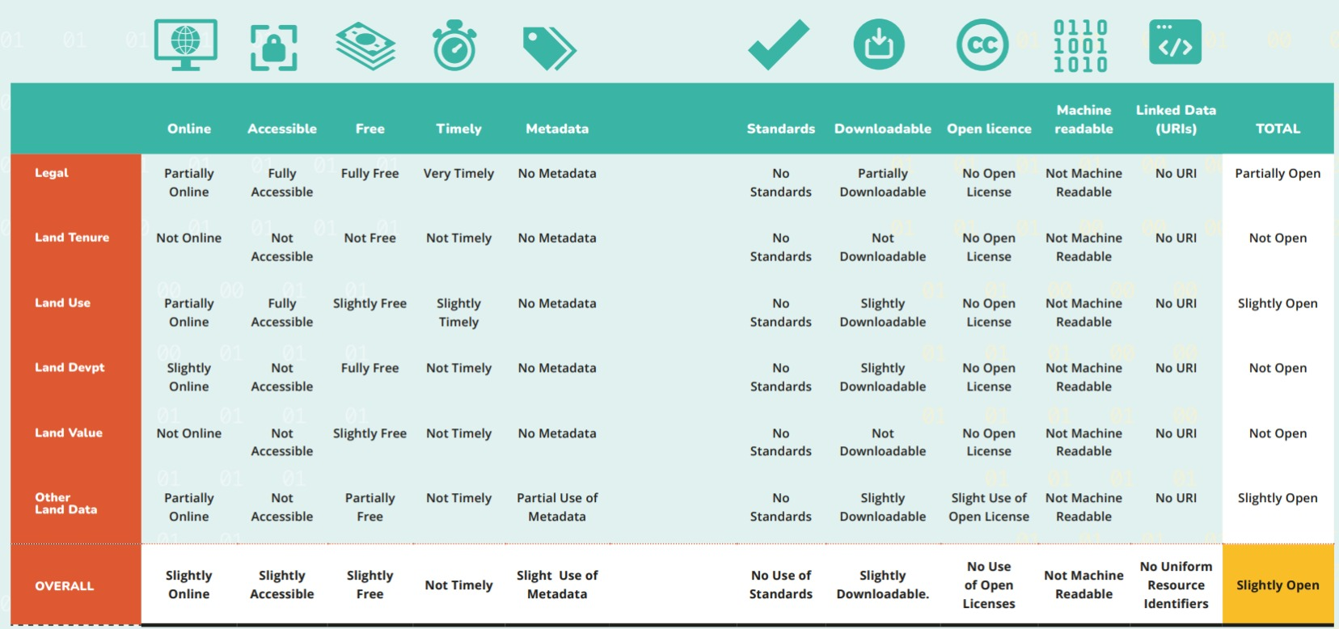
OVERALL RESULTS OF THE OPEN DATA ASSESSMENT FOR MADAGASCAR’S LAND DATA
Source: landportal.org

Slide 67
Blockchain-Based Land Registration System:
A Conceptual Framework

Slide 68
Blockchain Registry
Integration Framework
Blockchain Registry Integration Framework
Level | Name | Description | Example
0 | No Integration | No use of blockchain | Most of the world
1 | Blockchain Recording | Public blockchain used to record documents related to land transactions | Brazil, Georgia, Dubai
2 | Smart Workflow | Blockchain used to record progress of a transaction | Sweden, Dubai Properties (Landstream)
3 | Smart Escrow | Smart contracts used for escrowing payment Five Steps Block Chain based property acquisition | PROPY
4 | Blockchain Registry | Central database replaced with a permissioned blockchain | Dubai
5 | Disaggregated Rights | Various rights to a single parcel are disaggregated and managed via blockchain | No known example
6 | Blockchain Fractional Rights | Rights for a given parcel are fragmented and managed via blockchain | Pangea (potentially)
7 | Peer-to-Peer Transactions | Rights are transacted without intermediaries on Level 4 system | No known example
8 | Interoperability | Different blockchain registries merge | No known example

Slide 69
Blockchain for Land Registry
Blockchain for Land Registry
Blockchain for Land Registry - Administration of land and property involves a vast array of documents and supporting data.
Existing land information systems are typically centralized ledgers (databases) that provide a system of record of a nation’s land transactions.
A digital repository affords greater capabilities than the paper-based counterpart but, by itself, digitalization provides no intrinsic transformation to the land registration process.
Digitalization of paper-based land records adds redundancy, concurrency, and consistency, characteristics of database systems.
Ultimately this can lead to automation and introduce efficiencies to the process at the application layer (e.g., availability of information, protection against catastrophic loss or man-made disasters).
Many governments have leveraged on information and communication technologies (ICTs) to increase openness and transparency (e.g., e-Government, open data initiatives).
Distributed databases can help protect these central repositories through replication and duplication.
Nevertheless, the integrity of the records is still vulnerable to tamper and fraud by entities in the network that are not trustworthy (e.g., a rogue individual modifying or deleting land records).

Slide 70
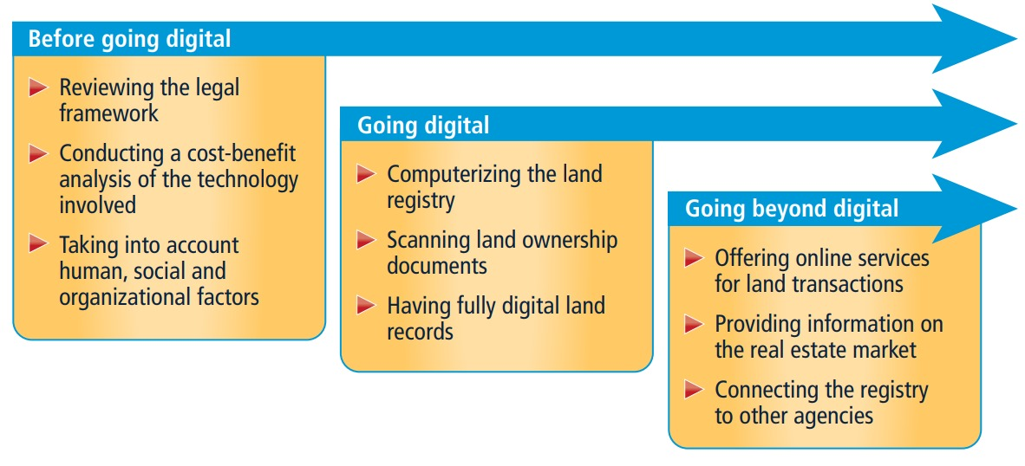
Figure 8.2 What are th
The Stages in Projects for Digitizing Land Records
Source: World Bank 2016

Slide 71
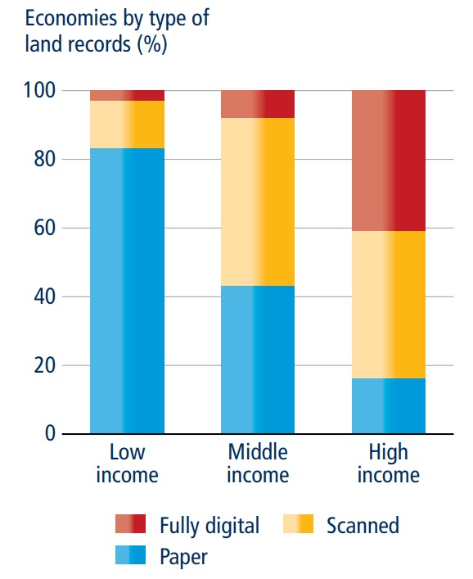
Figure 8.3 The type of land records varies
The Types of Land Records Varies Widely Across Income Groups
Source: World Bank 2016

Slide 72
Future of Blockchain for Real Estate
Future of Blockchain for Real Estate
Blockchain can ensure more reliable title insurance records, increasing efficiency and lowering costs.
The simplicity of the Torrens title system may provide the optimal legal framework for a blockchain registry (at higher levels) - since it mirrors the architecture of Blockchain.
Blockchain-based real estate markets can help drive financial inclusion within developing countries.
Blockchain registries and other stores of data can create an unprecedented tool for studying the impact of land governance policies, bringing land into big data.
Nations and States will retain the power to regulate and tax land transactions.

Slide 73

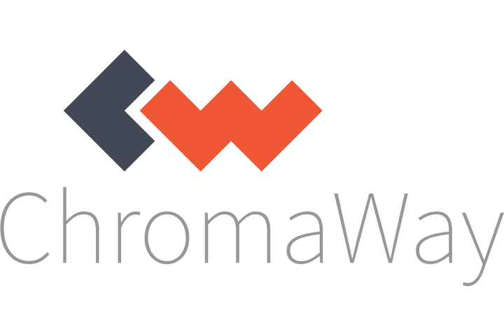




Current Examples of
Registries and Blockchain
Some Examples of Registries and Blockchain
Company | Product | Geographic Location of Pilot
 | Exonum | Republic of Georgia, Ukraine
 | Postchain | Sweden, India, Australia
 | Landstream, Pangea | Dubai
 | Unnamed SaaS, OpenTitle | Honduras
 | Propy Registry | Ukraine, Vermont
 | Parallel Registry Utilizing Colu Colored Coin Protocol | Brazil

Slide 74
Design of Land Administration and Title Registration Based on Blockchain Technology
Design of Land Administration and Title Registration Based on Blockchain Technology

Slide 75
Land Assembly / Acquisition
Blockchain technology can be applied to the process of land assembly and acquisition in the context of the Community Advancement through Affordable Housing (CAHF) program in several ways:
SMART CONTRACTS: Replace paper contracts with digital contracts. Data is kept in the blockchain network and may be retrieved when needed. Binding all participants to the terms established in the smart contract. Can be used to automate the transfer of ownership and payment (execute automatically) once all the conditions of the sale have been met. Reduces the time and cost associated with the traditional legal process of land transfer.
TRANSPARENCY AND IMMUTABILITY: provides a tamper-proof record of all transactions on the Blockchain to prevent fraud and disputes over ownership or payment. Once a transaction has been recorded, it cannot be altered.
DECENTRALIZATION: Allows for decentralized ownership and management of assets, this could mean that ownership of land is distributed across a network of stakeholders, rather than being concentrated in the hands of a few powerful actors.
TRACEABILITY: By tracking the provenance of land on the Blockchain, it is possible to ensure that it has not been obtained through illegal means such as corruption, deforestation, or human rights abuses. This can help to promote ethical land acquisition practices

Slide 76
TITLE/ TENURE: Digital Title Deeds
Blockchain Technology can be used to create a secure digital registry of property ownership and transfers.
This would replace the vulnerable paper-based systems used in many countries, reducing the risk of fraud and corruption.
By using Blockchain, ownership records would be stored in a decentralized, immutable ledger that is transparent and accessible to authorized parties.
Transactions would become faster and more efficient, and there would be greater transparency and accountability in the property market.
The risk of fraudulent transactions would be reduced, as each transfer of ownership would require consensus among a network of nodes, making it difficult to manipulate the system.
Blockchain technology could make it easier to verify the authenticity of property titles and resolve disputes over ownership or title transfers.
Implementing Blockchain technology could improve the efficiency and transparency of property markets.

Slide 77
Technical Overview
Components of Blockchain Solutions

Slide 78
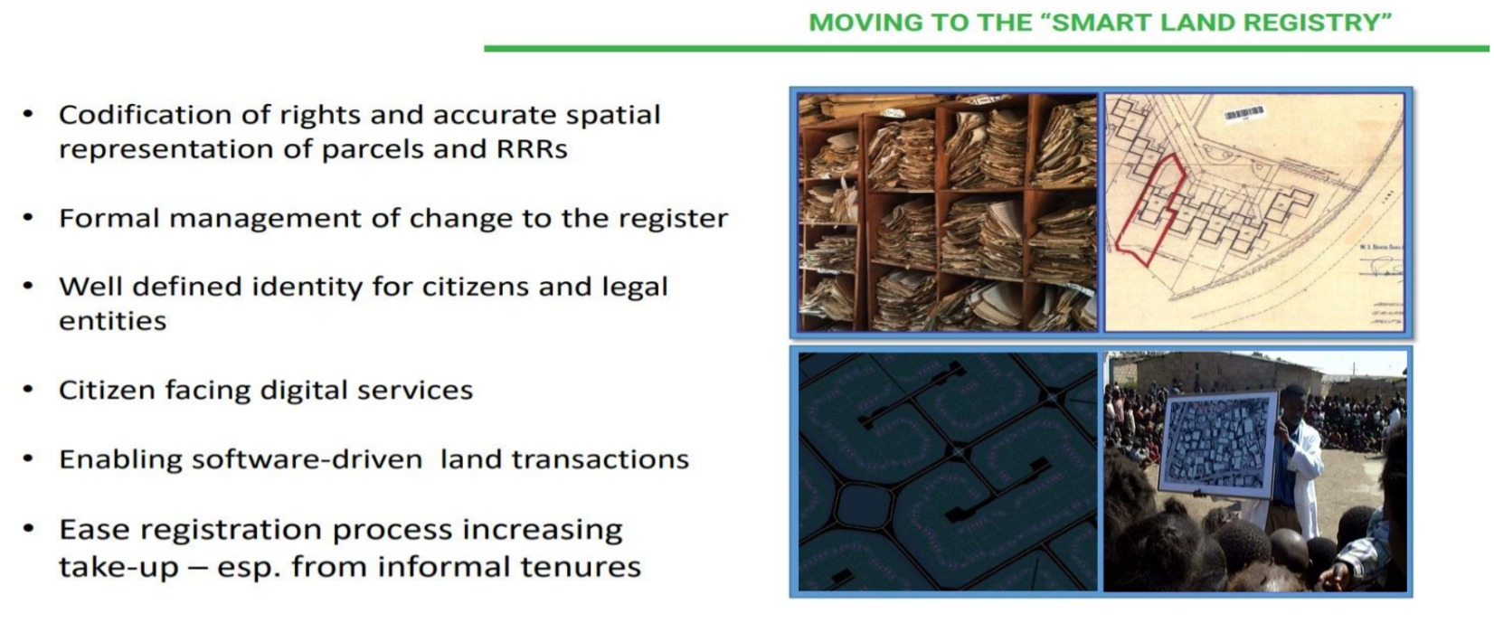
TOWARDS A SMART LAND REGISTRY

Slide 79
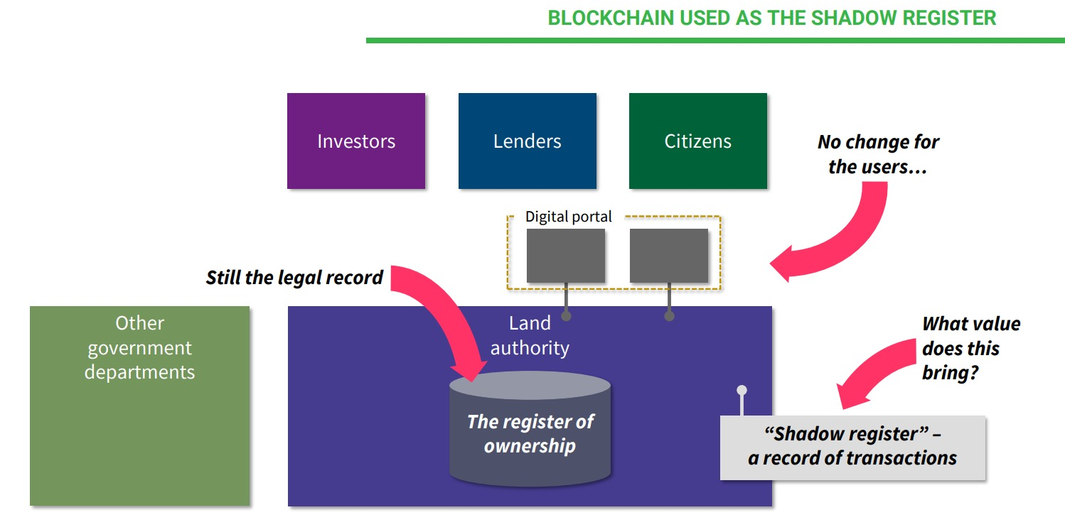
BLOCKCHAIN-BASED LAND REGISTRY

Slide 80

BLOCKCHAIN-BASED LAND AUTHORITY

Slide 81

BLOCKCHAIN-BASED LAND AUTHORITY…

Slide 82

BLOCKCHAIN-BASED LAND AUTHORITY…

Slide 83

Blockchain Use in the Land Transaction Process

Slide 84
BLOCKCHAIN-BASED LAND AUTHORITY
Challenges and Benefits
What are the legal implications.
Benefits of increased market liquidity.
Who hosts the chain?
Technical challenges to using the technology
Increase trust with high visibility and third-party validation of transactions
Smooth the information flow across government and business entities.
Increase market liquidity.
Supports high-trust foreign investment

Slide 85

DUBAI REAL ESTATE
BLOCKCHAIN SOLUTION TO ENABLE LAND REGISTRATION – NETWORK PERMISSION

Slide 86
PRACTICAL APPLICATION OF BLOCKCHAIN:
LAND ASSEMBLY/ACQUISITION
Country / Institution | Application of Blockchain to Land Assembly / Acquisition
Sweden's Land Registry | Tested a Blockchain-based system for registering land titles in 2016 to prevent fraud and errors in the land registration process.
Georgia’s - National Agency of Public Registry | Use of Blockchain technology to register land titles in 2017 through the "Blockchain Land Titling Project" to reduce corruption and disputes over land ownership.
Ghana - Bitland | Blockchain-based platform - allows individuals and communities to register and verify land titles using GPS to prevent disputes over land ownership.
Global - PROPY | Blockchain-based platform for buying and selling properties using smart contracts to reduce transaction costs and ensure secure & efficient transactions.
Ubiquity | Blockchain-based platform that allows individuals and organizations to record and verify real estate transactions using smart contracts to reduce fraud and errors in the transaction process.

Slide 87
PRACTICAL APPLICATION OF BLOCKCHAIN TO TITLE/ TENURE - AFRICA
Country / Institution | Application of Blockchain to Title / Tenure in Africa
Kenya - Land Layby | Startup using Blockchain technology for recording land buying and selling transactions. The platform uses smart contracts to automate the transfer of ownership, which reduces the time and cost of the transfer process.
Ghana - BenBen | Proptech startup that uses Blockchain technology to provide a secure and transparent way for individuals and businesses to record and verify property transactions. Uses a private Blockchain network to create a tamper-proof ledger of ownership records, which reduces the risk of fraud and corruption in the property market.
Nigeria - LandChain | Blockchain-based platform developed by the Nigerian government to help individuals and businesses to register and verify land titles. The platform uses a private Blockchain network to create a secure and transparent ledger of ownership records.
Nigeria - HouseAfrica | Proptech startup that uses Blockchain technology to create a secure and transparent way for individuals and businesses to register and verify property titles.

Slide 88
Section Six
BLOCKCHAIN TOKENIZATION
REAL ESTATE TOKENIZATION

Slide 89

BLOCKCHAIN TOKENIZATION
Source: Getty Images

Slide 90
What are Digital Securities?
What are Digital Securities?
What are Digital Securities?
Digital securities take the form of tokens on a secure distributed ledger (known as blockchain).
Digital securities offer key benefits over more traditional forms of securities, including instant settlement and cost-free custody.
Digital securities primarily fall under securities regulation of any jurisdiction but may also extend to the Central bank.
Digital Tokens in Nigeria will fall under the supervision of the Securities and Exchange Commission (SEC) with respect to the tokenized asset and the Central Bank of Nigeria with respect to the use of digital currency in transaction settlement.

Slide 91
BLOCKCHAIN TOKENIZATION IN REAL ESTATE
Recap Problems of Real Estate Investment
Inefficient transfer and record keeping processes: Administrative work = 50% to 75% of an issuers total operating cost.
Illiquidity – About 1% of global real estate assets are traded on national stock exchanges.
Inaccessibility – Most people are excluded from trading in real estate.
Lack of Transparency – A lot of real estate market suffer from a critical lack of transparency
Tokenization Solves the Problems
Automation of middlemen processes: Tokenization saves $1.7 billion in the US alone.
Improved Liquidity: Cost effective secondary market fractionalization.
Lowered Barrier to Investment: Tokenization enables fractionalization + significantly reduced transaction administration costs.
Increased Transparency: Tokenizing real estate will make the market more transparent

Slide 92

BLOCKCHAIN TOKENIZATION IN REAL ESTATE
Tokenization refers to the process of converting an asset into a digital token.
In the context of real estate, tokenization involves dividing a property into smaller fractional ownership units, which can then be represented by digital tokens on a Blockchain that can be stored and traded on a Blockchain.
These tokens can be bought and sold, providing investors with a way to invest in real estate without the need for large sums of capital.

Slide 93

BLOCKCHAIN TOKENIZATION IN REAL ESTATE

Slide 94

Comparison of Traditional and Digital Assets

Slide 95




TOKENIZATION IN AFFORDABLE HOUSING
01
Tokenization:
Conversion of an asset into a digital token.
02
Real Estate Tokenization:
Process of dividing a property into smaller fractional ownership units
03
Representation on Blockchain:
Digital tokens on a blockchain represent ownership units.
04
Investment Accessibility:
Enables investment in real estate with smaller capital.
04
Buy and Sell Opportunities:
Tokens can be bought and sold by investors.

Slide 96
MULTIPLIER EFFECT OF TOKENIZING
ON AFFORDABLE HOUSING MARKET
Fractional Ownership:
Lower Transaction Costs:
Efficient Capital Deployment:
Enables a broader range of individuals to participate in real estate investments
This increased participation can lead to more diverse sources of funding for affordable housing projects.
Reduced transaction costs mean that more funds can be directed toward actual property development and improvement rather than being spent on intermediary fees
With a more efficient and accessible investment environment, capital can be deployed more quickly and effectively.
This agility in capital deployment can contribute to a multiplier effect by accelerating the development and completion of affordable housing projects.
Increased Liquidity:
Access to Global Investors:
Community Participation:
Liquidity allows for more frequent transactions in the real estate market.
The increased transaction volume can stimulate economic activities
The inflow of international capital through tokenization can have a multiplier effect on the funding available for affordable housing, fostering economic growth and development.
Increased transparency and fractional ownership can encourage community participation and engagement.
When communities are actively involved in the development process, the multiplier effect extends to social and economic benefits within the community.

Slide 97

Illustration of Digital Securities Platform

Slide 98

Illustration of Fractional Ownership and Liquidity

Slide 99
Changing the Role of Private Market Assets in a Portfolio
Current
Digital Securities Platform eg ADDX
High risk, high return
Long-term return enhancement
Risky due to
  Long tenors
  Non existent secondary market
  High entry ticket size ($1m and above)
  Potentially volatile underlying asset
Fractional ownership solves high entry ticket sizes – allows use of private market assets as diversification tool for portfolio of all sizes.
Secondary market solves risk associated with long tenor.
Shelf of product range from higher risk/ return to safer yield type product (e.g. Astree, CGS – CIMB Securities)

Slide 100
POTENTIAL APPLICATION OF BLOCKCHAIN TOKENIZATION IN REAL ESTATE:
Fractional Ownership: Tokenization allows for fractional ownership, meaning that investors can own a portion of a property instead of having to purchase the entire property. This allows for smaller investors to participate in real estate investments that were previously inaccessible.
Increased Liquidity: By digitizing real estate assets, tokenization can increase liquidity in the market, as investors can easily buy and sell their fractional ownership units on a Blockchain platform.
Lower Transaction Costs: Blockchain technology eliminates the need for intermediaries, such as brokers and lawyers, reducing transaction costs for both buyers and sellers.
Improved Transparency: Blockchain technology provides a secure, transparent, and immutable record of all transactions, making it easier to track ownership, verify property ownership, and prevent fraud.
Access to Global Investors: Tokenization allows for global access to real estate investments, as investors from all over the world can participate in the market without the need for geographic proximity.

Slide 101
PRACTICAL APPLICATION OF BLOCKCHAIN
TOKENIZATION IN REAL ESTATE
Institution | Application of Blockchain to
PROPY | Enables the purchase and sale of real estate properties using digital tokens. Propy's platform allows for tokenization of properties, making it easier for investors to invest in real estate with lower transaction fees and increased transparency.
RealT | Tokenization platform that allows investors to purchase fractional ownership of properties using digital tokens. Tokenizes properties and makes them available for investment on its platform. Manages the properties and distributes the rental income to investors.
Harbor | Platform allows the creation and sale of security tokens, including real estate investments. Provides regulatory compliance and facilitates the trading of security tokens on a Blockchain.
SwissRealCoin | Enables fractional ownership of Swiss real estate properties. Tokenizes real estate assets and allows investors to purchase fractional ownership units, which can be traded on a Blockchain.
Slice | Allows investors to purchase fractional ownership of high-end residential properties in New York City. Tokenizes properties and makes them available for investment using digital tokens. Investors can trade their tokens on a Blockchain-based platform.

Slide 102

TOKENIZATION PLATFORM IN REAL ESTATE

Slide 103
Challenges and Opportunities
Legal / Structure
Amendments to existing issuance documentation
Novel structures
Regulatory
Clarity in tax treatment
Operational support from institutions (e.g. stamp duty)
Transparency
Acceptance of DLT technology / Confusion with crypto

Slide 104
Section Seven
MULTIPLIER EFFECT OF DIGITIZATION ON AFFORDABLE HOUSING

Slide 105





MULTIPLIER EFFECT
The multiplier effect in finance refers to the amplification of an initial economic stimulus or change in spending that leads to a larger impact on overall economic activity.
This concept is often associated with fiscal policy, where an initial injection of money into the economy, such as government spending or tax cuts, sets off a chain reaction of increased spending and income.
HOW IT WORKS
Initial Spending:
Secondary Spending:
Repeat Process:
Let's say the government increases spending on infrastructure projects. This is the initial injection of money into the economy.
The individuals and businesses who received the increased income now have more money to spend. They, in turn, spend this additional income on goods and services.
This cycle continues, with each round of spending leading to additional rounds of income increases and spending.
Further Income Increases:
Increased Income
The workers and businesses involved in these projects receive payments, increasing their income.
The recipients of the secondary spending experience an increase in income, leading to more spending.

Slide 106








MULTIPLIER EFFECT OF AFFORDABLE HOUSING
Housing market multiplier effect refers to the amplification of economic activity triggered by changes in the housing market
When the housing market experiences shifts, whether it be in prices, construction, or availability, it sets off a ripple effect that resonates throughout the economy.
One of the key factors driving the housing market multiplier effect is the interplay between supply and demand.
As demand rises, so does the need for construction materials, labor, and services associated with the housing market.
This, in turn, stimulates job creation and increases economic output in related industries such as construction, real estate, and home furnishings.

Slide 107
DIGITIZING THE MORTGAGE MARKET CAN HAVE A RIPPLE EFFECT ON VARIOUS ECONOMIC ACTIVITIES,
CONTRIBUTING TO INCREASED DEMAND IN SEVERAL SECTORS
Faster Processing and Approval:
Impact: Digitization streamlines the mortgage application and approval process, reducing the time it takes to secure a mortgage.
Effect: This can lead to increased demand for real estate transactions as potential buyers can move more quickly in making purchasing decisions.
Data-Driven Decision-Making:
Impact: Digital technologies enable better analysis of borrower data.
Effect: Lenders can make more informed lending decisions, expanding the pool of eligible borrowers and increasing demand for housing.
Efficient Financial Transactions:
Impact: Digital mortgages involve electronic financial transactions and documentation.
Effect: Increased efficiency in financial transactions can contribute to a faster turnover of funds, potentially leading to increased investment in real estate and related sectors.
Job Creation in Technology and Finance:
Impact: The development and maintenance of digital mortgage platforms require skilled professionals.
Effect: Job creation in the technology and finance sectors can lead to increased consumer spending, contributing to economic growth
Access to a Broader Market:
Impact: Digital platforms can provide broader access to mortgage products and services.
Effect: This can stimulate demand from a wider pool of potential homebuyers.
Stimulating Home Improvement and Furnishing Industries:
Impact: Increased home sales may stimulate demand for home improvement and furnishing services.
Effect: Increased new home owners, could lead to an increase in spending on renovations, furniture, and other related products.

Slide 108
Job Creation Multiplier Effect - Illustration
2018 Family Homes Funds (FHF) indicate plans to support development of 500,000 homes
Projected Job creation 1.5 million grassroots / low income jobs by 2023.
Over 4000homes under construction in five states: Ogun, Nasarawa, Kano, Delta and Kaduna.
Construction of 400 homes complete in Grand Luvu, Nasarawa State – jobs created – 8000.
Average cost per home – N3.5 million

Slide 109
Section Eight
AFFORDABLE HOUSING – NEED FOR POLICY
THE IMPERATIVES OF POLICY FOR THE BIGGEST IMPACT

Slide 110
THE NEED FOR IMPACTFUL HOUSING POLICY
National Housing Policy should focus of delivering affordable housing for target groups with the biggest impact:
Informal (slump) settlements where the residents to foster inclusion and attain several SDGs (SDG 3, 4, 5, 7, 8, 9, 10, 11)
First time home owners
The B40 – Social Housing

Slide 111
Affordable Housing Funding Source
 | Asset Size (N) & Euro for UK | Percent of Total | Percent of PenCom & UK Pensions
FMBN | 140,100,000,000.00 | 29% | 0.84%
FHFL | 93,000,000,000.00 | 20% | 0.55%
NMRC | 24,020,000,000.00 | 5% | 0.14%
FHA |  | 0% | 0.00%
PENCOM ASSETS | 219,276,000,000.00 | 46% | 1.31%
SUB TOTAL | 476,396,000,000.00 | 100% | 2.84%
PENCOM | 16,760,000,000,000.00
PENCOM ASETS INVESTMENT @ 5% | 838,000,000,000.00 |  | 5.00%
UK PENSION FUND UK Govt plans incentives for Pension Funds to Build Affordable Housing – Jeremy Hunt Chancellor: 14 Nov. 2023. Source: Various | 1,757,000,000,000.00 On 22nd Nov 2023 UK Govt. plans bigger pension schemes to invest in start-up companies . Mansion House Compact – voluntarily commit 5% |  | 5.96%

Slide 112
Conclusion
Digitization is a critical step in the journey of developing affordable Housing to harness the Investment Opportunity—and meet Challenge of affordable housing in Nigeria and the continent.
The prospect of trying to fill a gap of 20+ million housing units in Nigeria may seem daunting to policy makers, but it is a massive opportunity for the private sector in partnership with the public sector.
The investment associated with building the housing needed to close this gap is huge but the avenues for raising funds for the construction of new houses in Nigeria exists, it requires the will, desire and commitment to do so.

